Slide 1
EQA Educational cases (50)
Dr Sarah Liptrot

Slide 2
Case 1
Male 72 years with multiple enlarged lymph nodes in neck.
Microscopy shows partial involvement of nodal tissue by aggregates of large uniform cells with ovoid/indented vesicular nuclei and abundant eosinophilic cytoplasm. The large cells are associated with sheets of eosinophils. There are areas of necrosis related to the eosinophilic foci.
The phenotype of the large cells is as follows:
Positive: CD2, CD4, Cd30, CD68, S100, CD1a, Langerin, BCL2, BCL6, CXCL13, CYCD1
Negative: Cd3, CD5, CD7, CD8, CD10, CD15, CD20, CD21, Cd23, MUM1, AE1/3, CAM5.2, CD56, CD57, TIA, GZB, TDT, PD1a, BF1, ALK and EBV

Slide 3
Case 1cont.
The appearances and immunohistochemical profile fit best with a diagnosis of Langerhans cell histiocytosis.
CD2 and CD30 expression is somewhat unusual. Also of note is a persistently abnormal FBC since 2015. This may be of relevance given that Langerhans cell histiocytosis in adults is frequently associated with a second neoplasm ( lymphoid or myeloid)

Slide 4
Case 2
72 year old female with polypoidal rectal mass.
Microscopy showed fragments of a malignant tumour comprising large expansile sheets of atypical cells with hyperchromatic irregular nuclei and abundant cytoplasm. Areas of necrosis also present.
The tumour cells display the following phenotype:
Positive: S100 and Melan A
Negative: CK7, CK20, CEA, ER, P40, P63, CK5/6, CDX2, P16, pax8, Cd34, Cd31, Cd45, Cd30, Cd3, Cd20, SMA, desmin, MSA

Slide 5
Case 2 cont.
The appearances and immunohistochemical profile are entirely in keeping with malignant melanoma.
Full staging is advised.

Slide 6
EQA 50
Educational Cases 3 and 4

Slide 7
Case 3
M 80 years. Scalp lesion excision. IHC – CD10 Desmin, Myo D1, Myogenin positive. Pancytokeratin, S100, melan A, p63, CD31, CD34, Actin, H – Cladesmon and Calponin negative

Slide 8
Responses
Cutaneous Rhabdomyosarcoma (+/- pleomorphic variant)
Leimoyosarcoma
Pleomorphic Dermal Sarcoma
Sarcoma
AFX

Slide 9
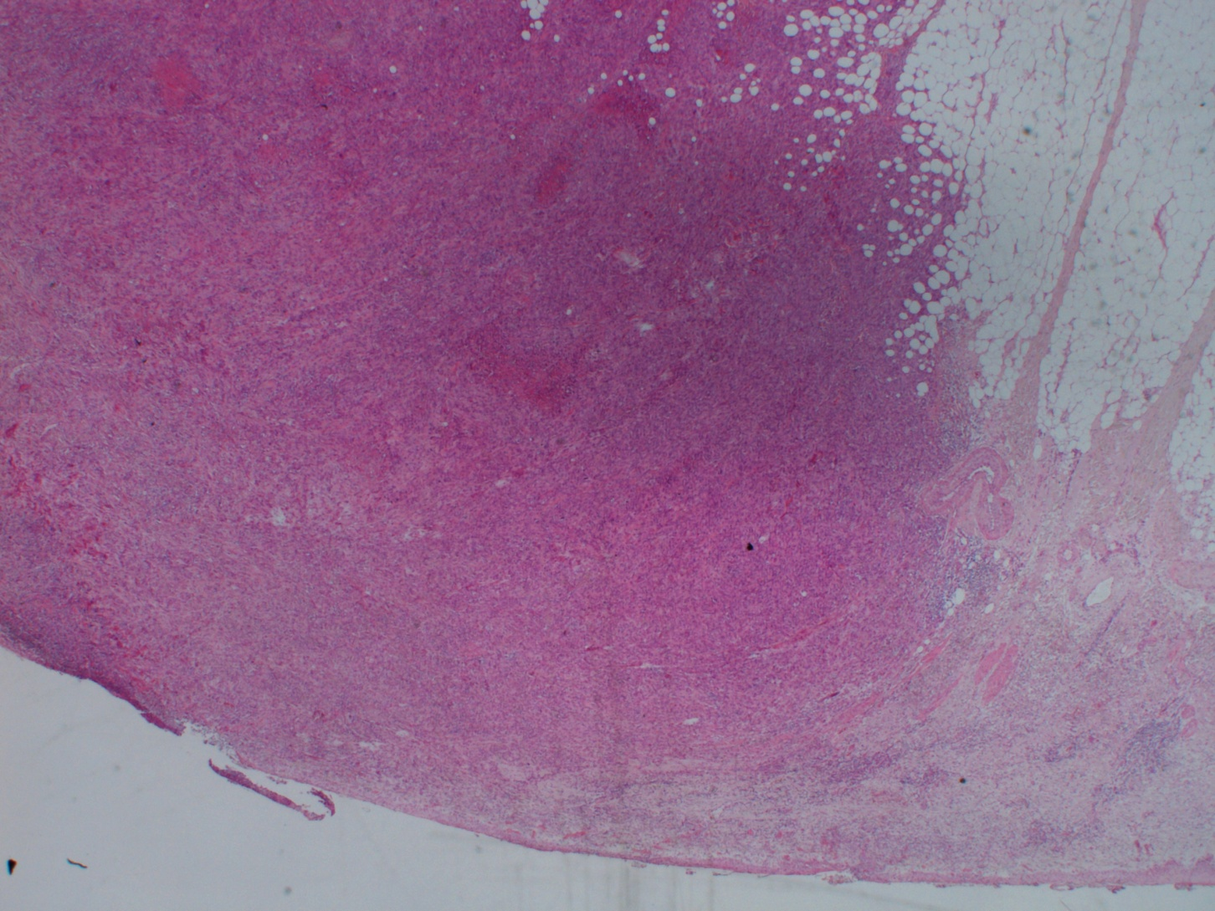

Slide 10
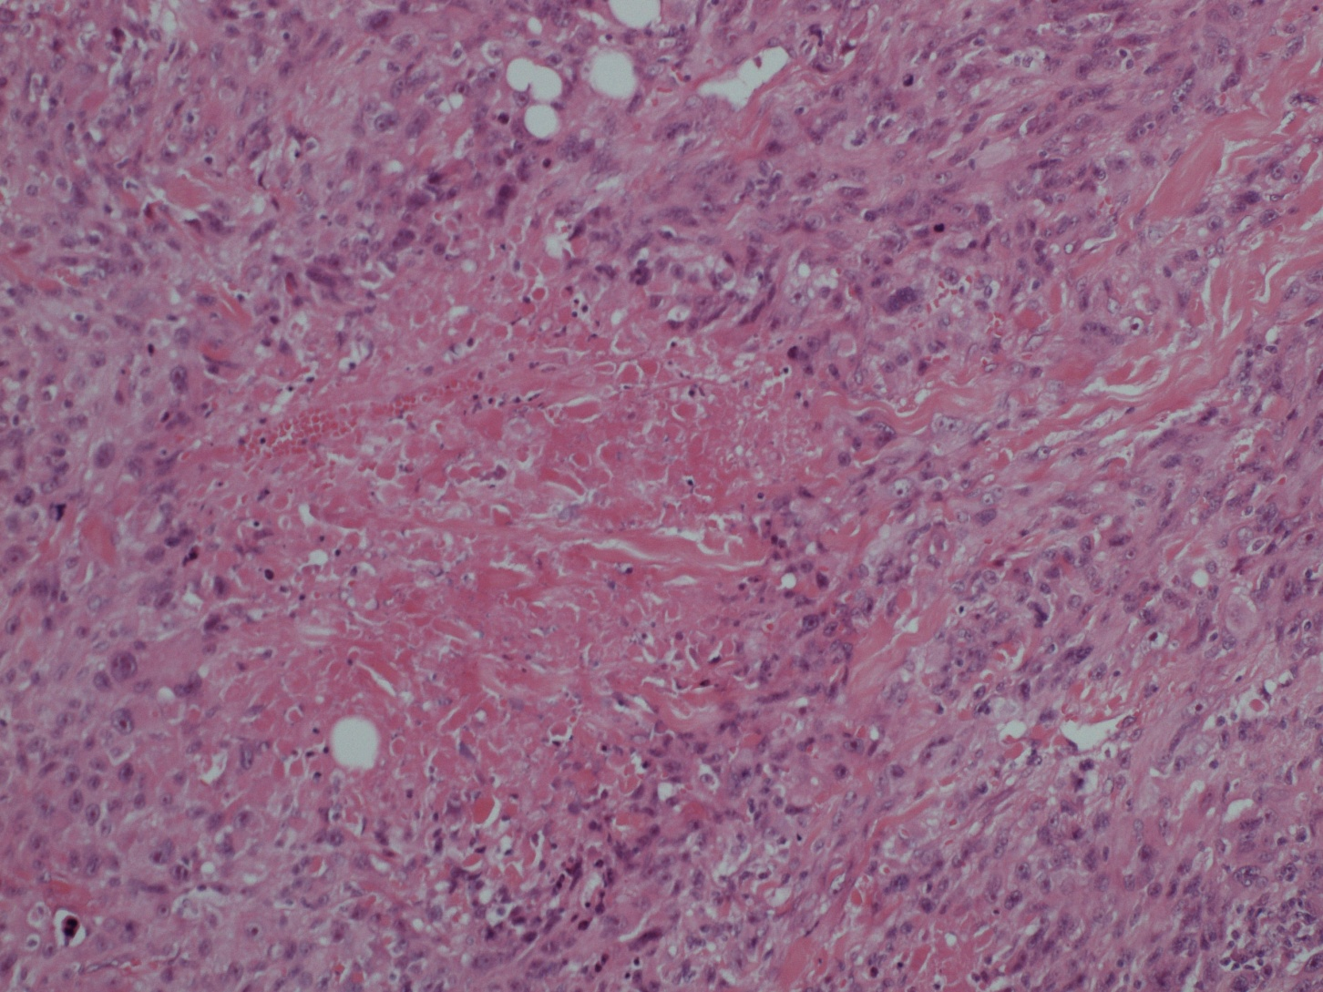

Slide 11
Pleomorphic Dermal Neoplasms
Spindle cell Carcinoma
Melanoma
Sarcomas
  Cutananeous Rhabdomyosarcoma (pleomrphic variant)
  Pleomorphic Dermal Sarcoma/AFX
  Leiomyosarcoma
  Cutaneous Angiosarcoma
  Myxofibrosarcoma
Fibrous Histiocytoma Variants

Slide 12
ICC
First Round
  Keratins and p63
  S100 and melanA
  CD 31 and CD 34
  CD 10 (+ve)
  Actin and Desmin (+ve)
Desmin not normally expressed in AFX/PDS
Second Round
  Myogenin, Myo–D1 (+ve)
  H-cal Desmon, Calponin

Slide 13
Cutaneous Rhabdomyosarcoma
Rare Cutaneous Sarcoma
No embryonal or alveolar component
Older individuals
Rapid growth
Painful lesion
Most common on the extremities although scalp in this case

Slide 14
Case 4
F 77 years. Probable left ovarian cancer. MNF 116, AE1/3, Synaptophysn, CD56 positive. Chromogranin, Inhibin, Calretinin, CD 99, ER, WT1, Vimentin negative.

Slide 15
Responses
High Grade Neuroendocrine Carcinoma
  Neuroendocrine Carcinoma
  Large Cell /Non Small Cell Neuroendocrine Carcinoma
  Small Cell Carcinoma
  Primary Vs Secondary
HGNC + Teratoma
HGNC + Brenner
Neuroectodermal malignant tumour
Granulosa cell tumour
Malignant Brenner tumour

Slide 16
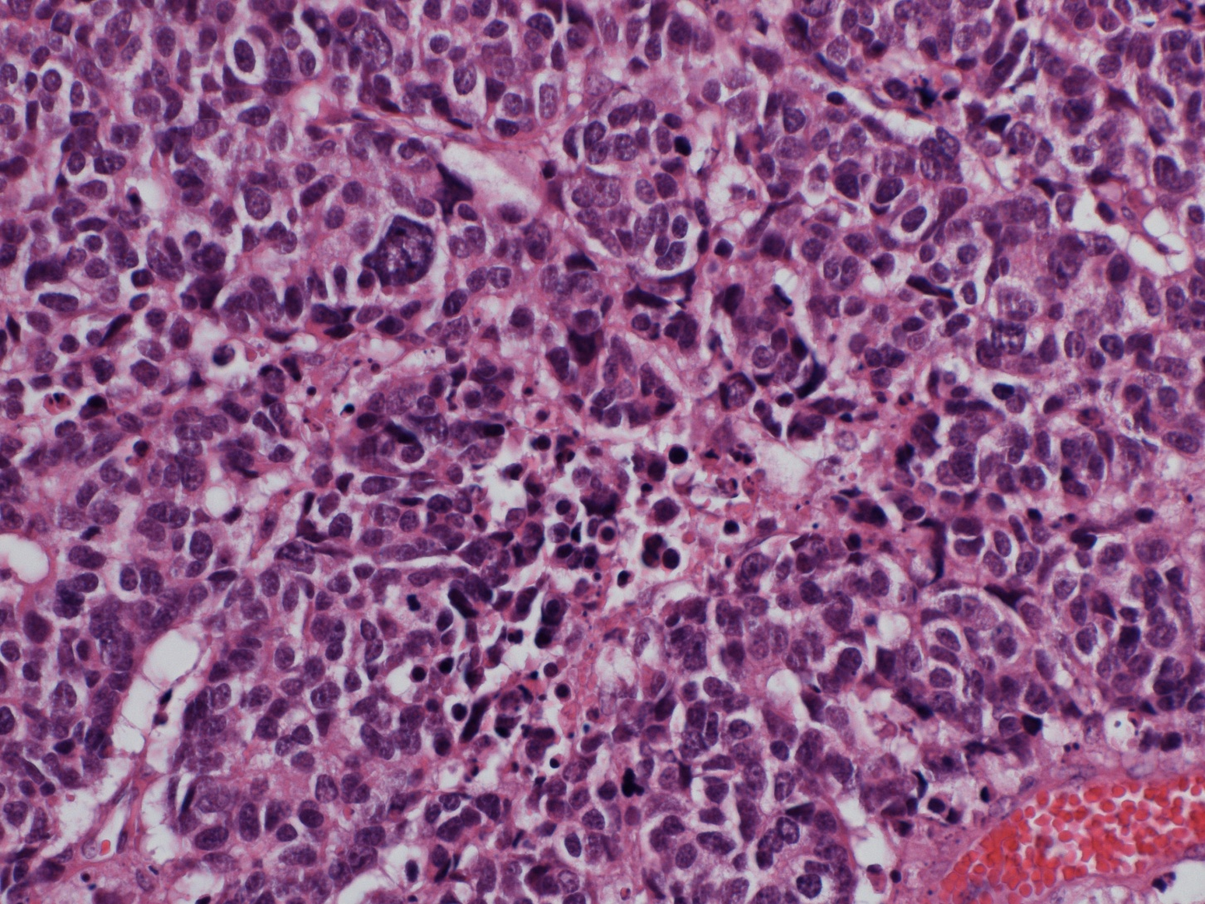

Slide 17
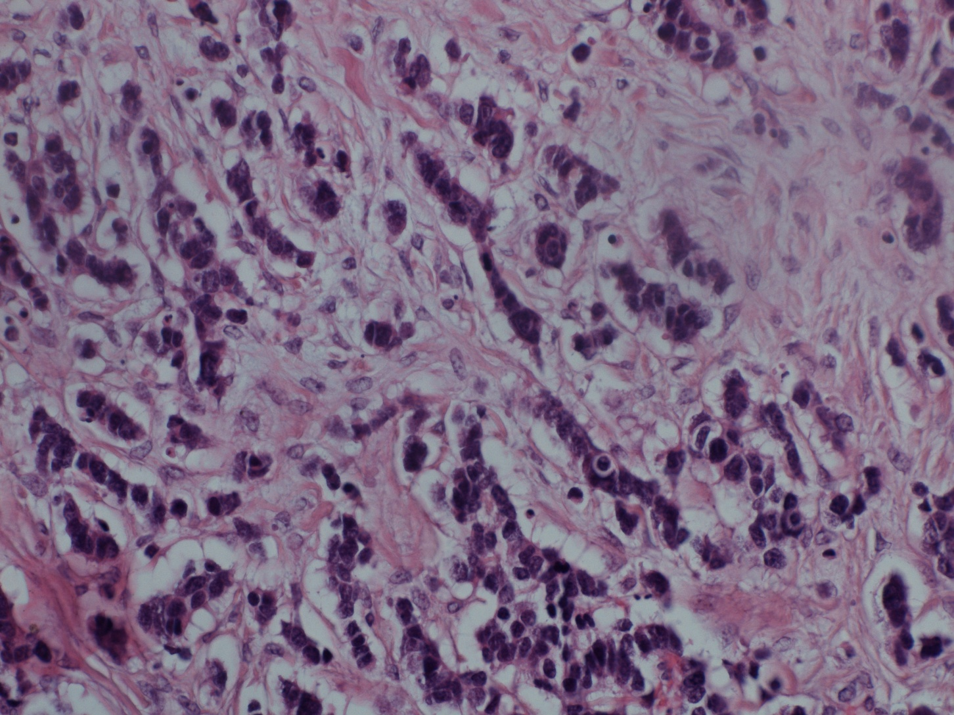

Slide 18
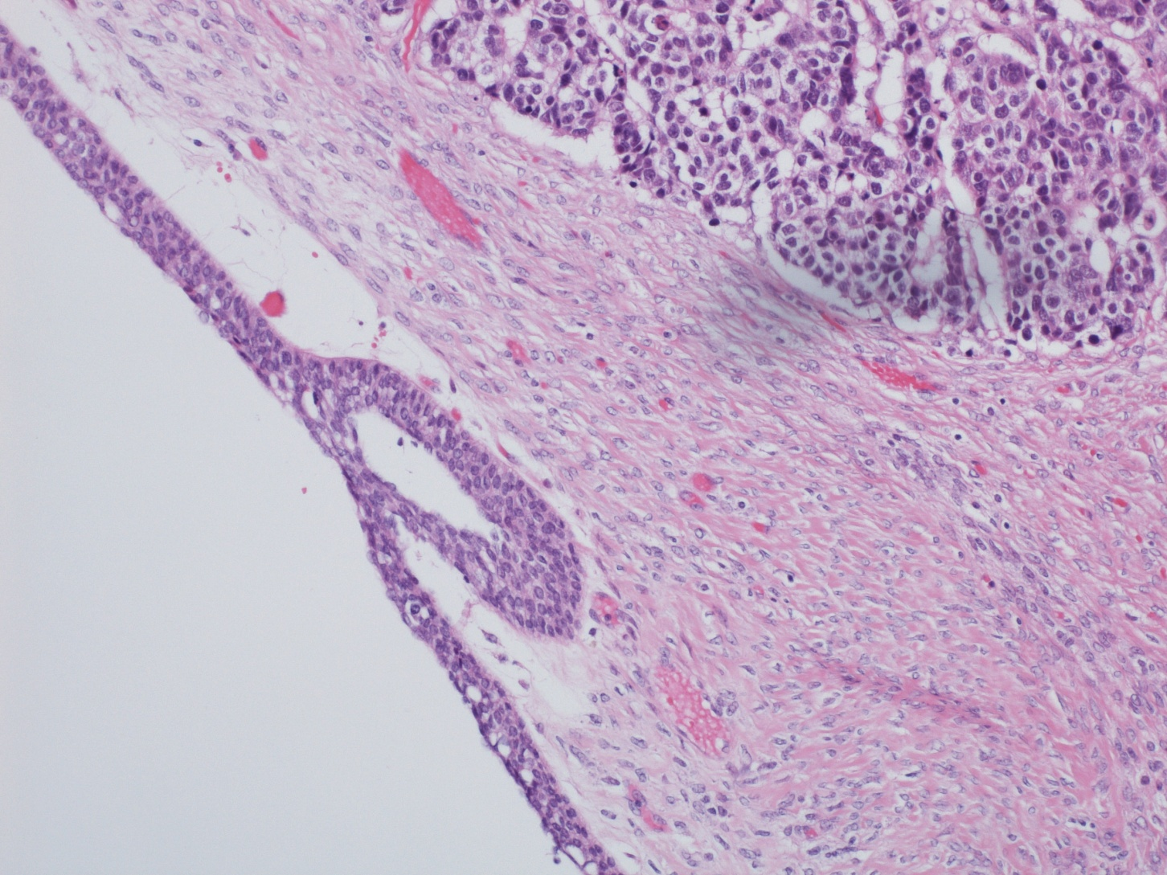

Slide 19
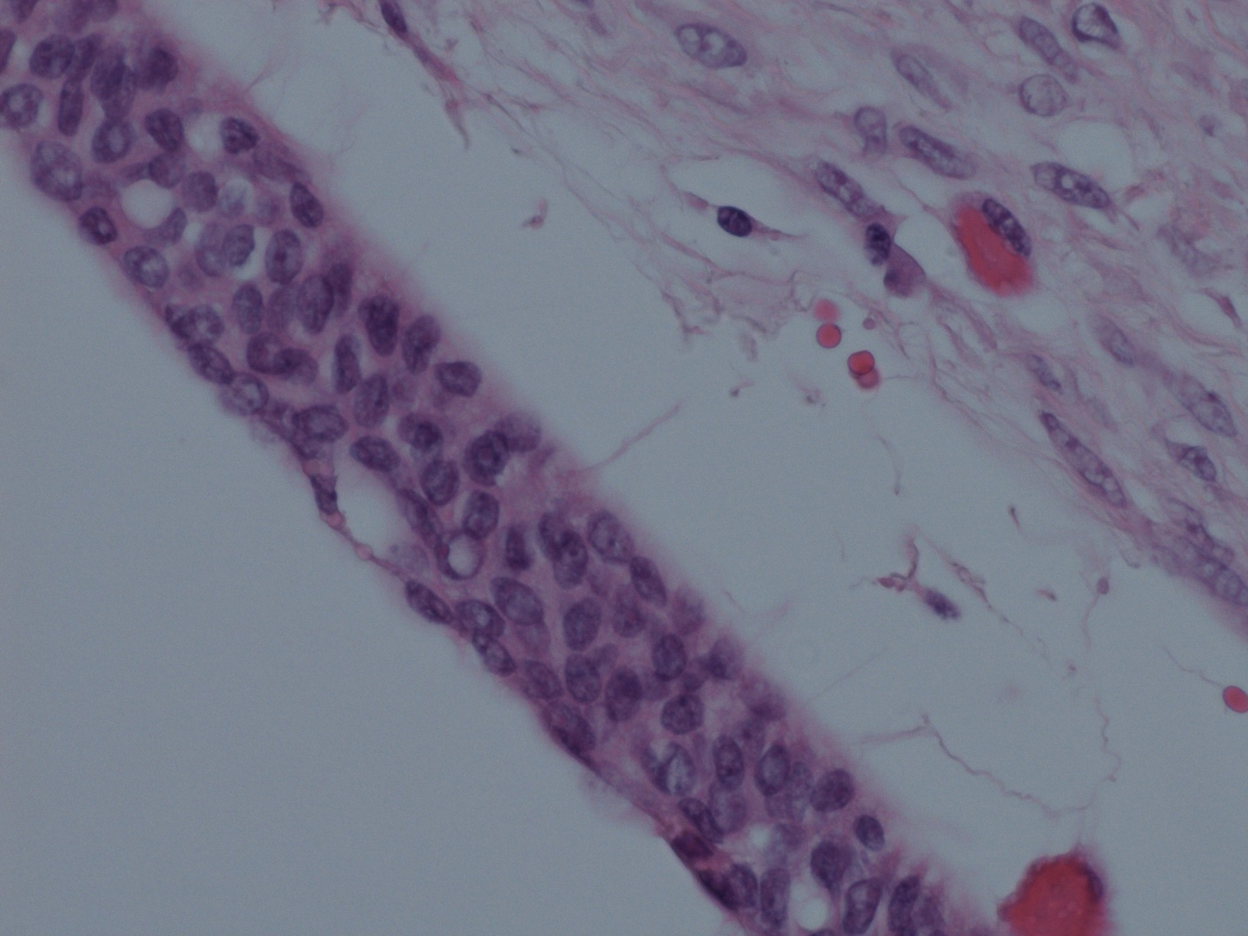

Slide 20
High Grade neuroendocrine carcinoma of Ovary
Rare Primary Neoplasm of Ovary
Can be have Small Cell or Large Cell Phenotype
Commonly associated with other epithelial tumours
Can also be associated with Teratomas

Slide 21
Poor prognosis
(This patient died within months of diagnosis)
Consider metastasis from other sites and correlate with radiology

