Slide 1
Scotland and Northern Ireland
EQA Scheme
Circulation 49
Cases F to H

Slide 2
Case F
F: 70 yrs Mastectomy for DCIS. Nipple block

Slide 3
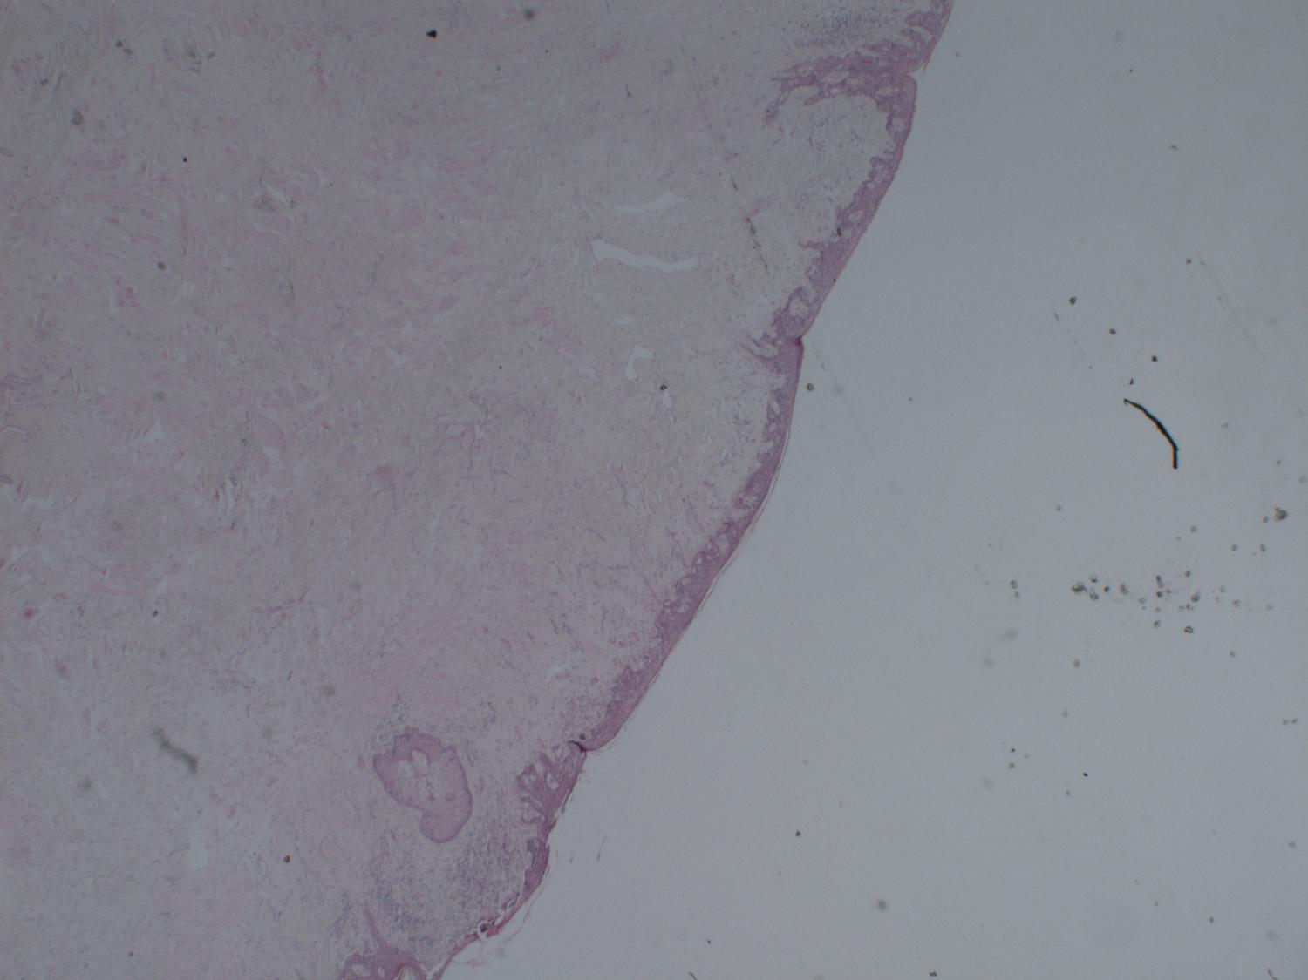

Slide 4
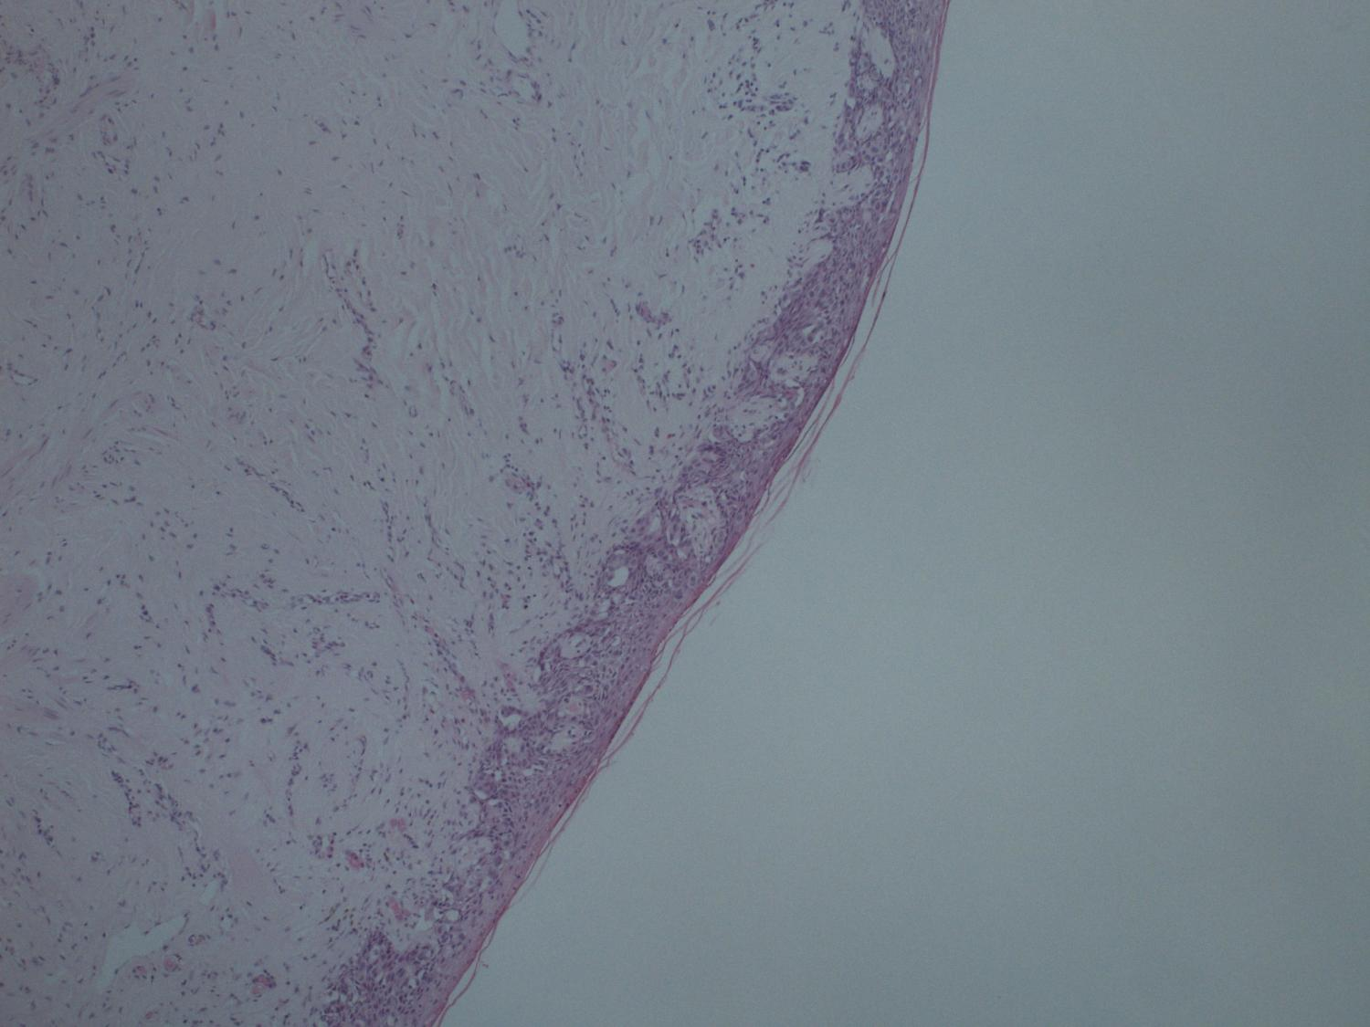

Slide 5
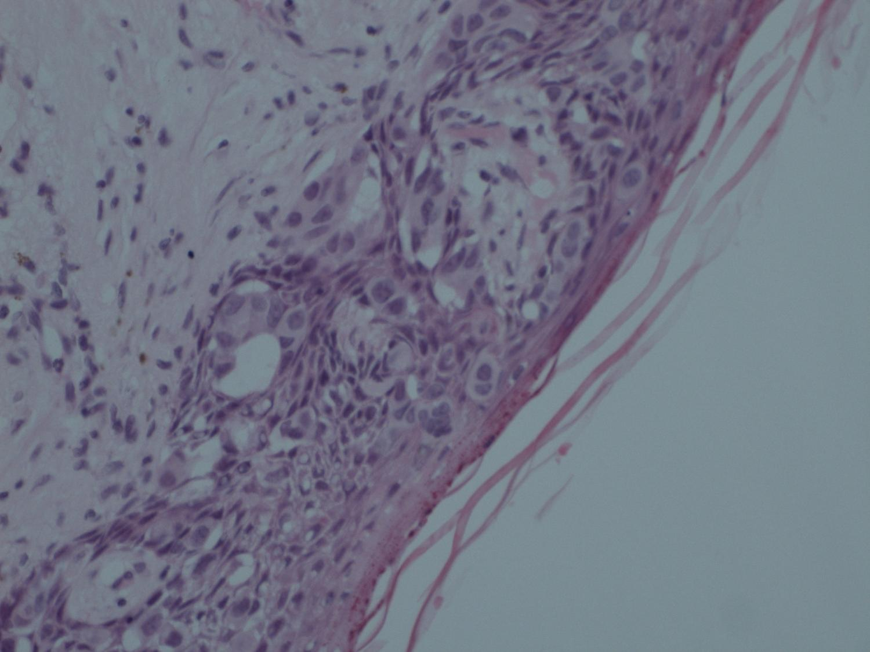

Slide 6
Case F
Diagnosis:
  Pagets Disease of Breast

Slide 7
Case F
Responses:
  All Score 1, Pagets diseases of nipple +/- DCIS

Slide 8
Case G
F: 69 yrs Punch biopsy left nipple. ? eczema

Slide 9
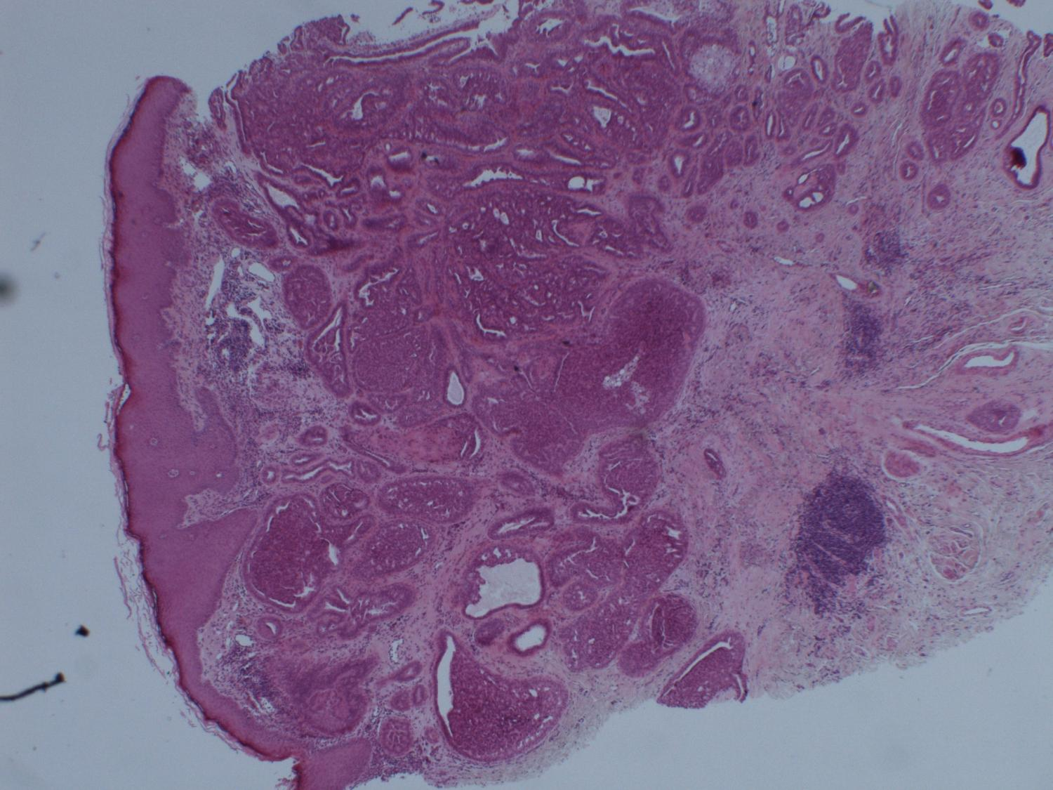

Slide 10
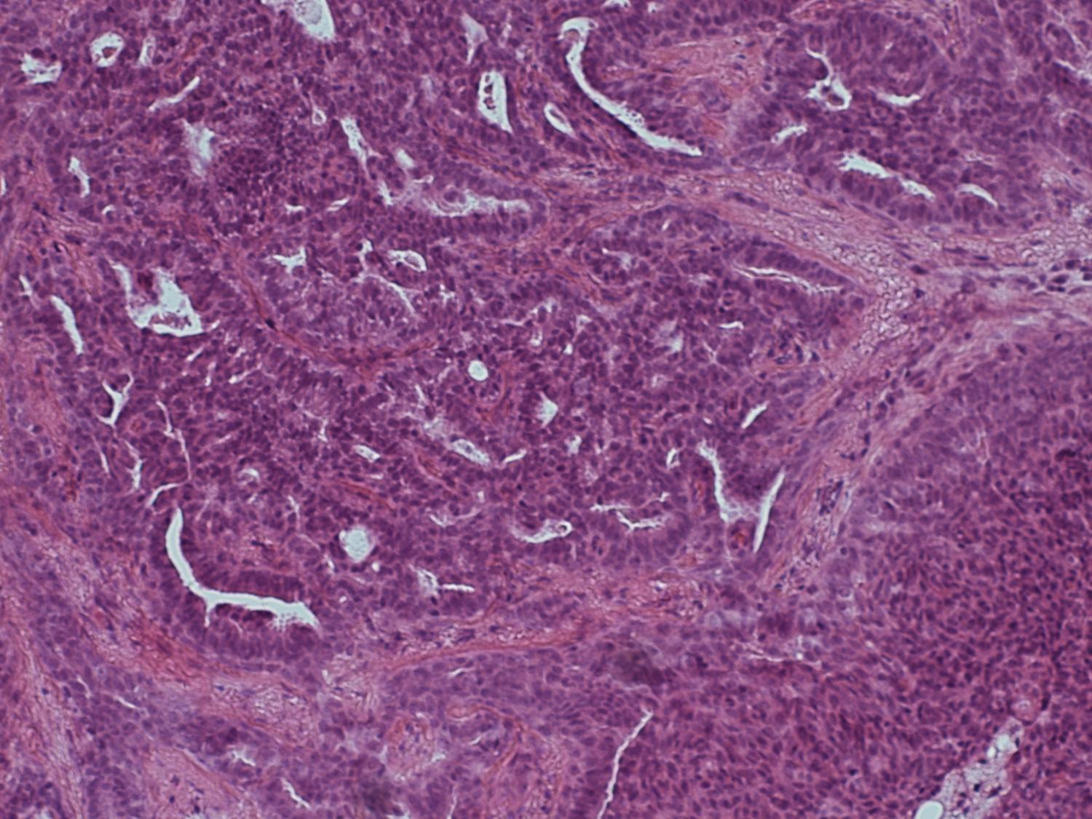

Slide 11
Case G
Diagnosis:
  Nipple Adenoma

Slide 12
Case G
Responses:
  Score 1
    Nipple adenoma

Slide 13
Case G
Responses:
  Score 2
    ?Hyperplasia of Usual Type
    Intraductal Papiloma

Slide 14
Case H
M: 46 yrs Random colonic biopsies. No clinical history given

Slide 15
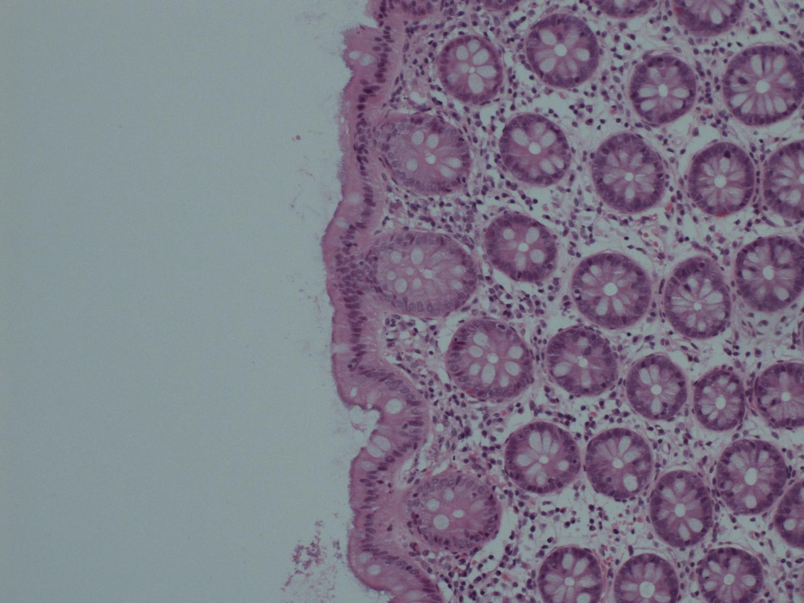

Slide 16
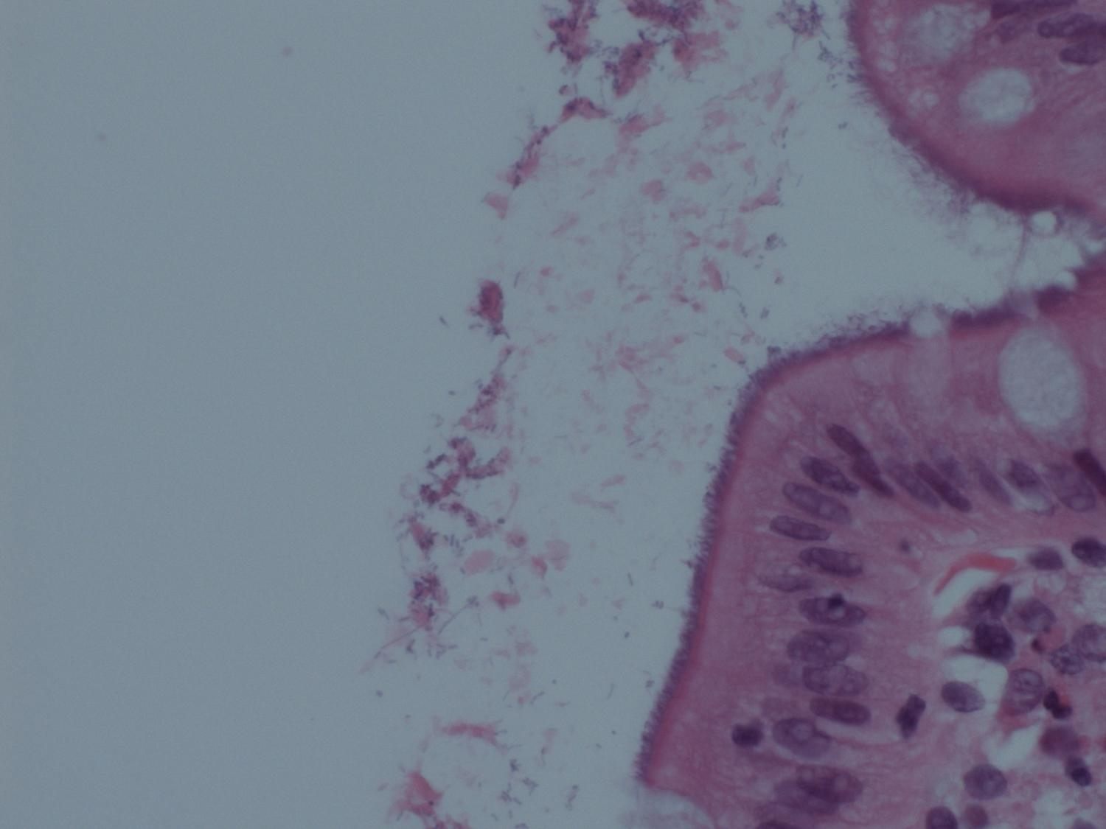

Slide 17
Case H
Diagnosis:
  Spirochetosis

Slide 18
Case H
Responses:
  Score 1 - Spirochetosis

Slide 19
Case H
Responses:
  Score 2
    Normal

Slide 20
Case I
F; 59 yrs Incidental mesenteric mass at colectomy for cancer. CD56, Chromogranin and synaptophysin positive. Sustentacular S100 staining

Slide 21
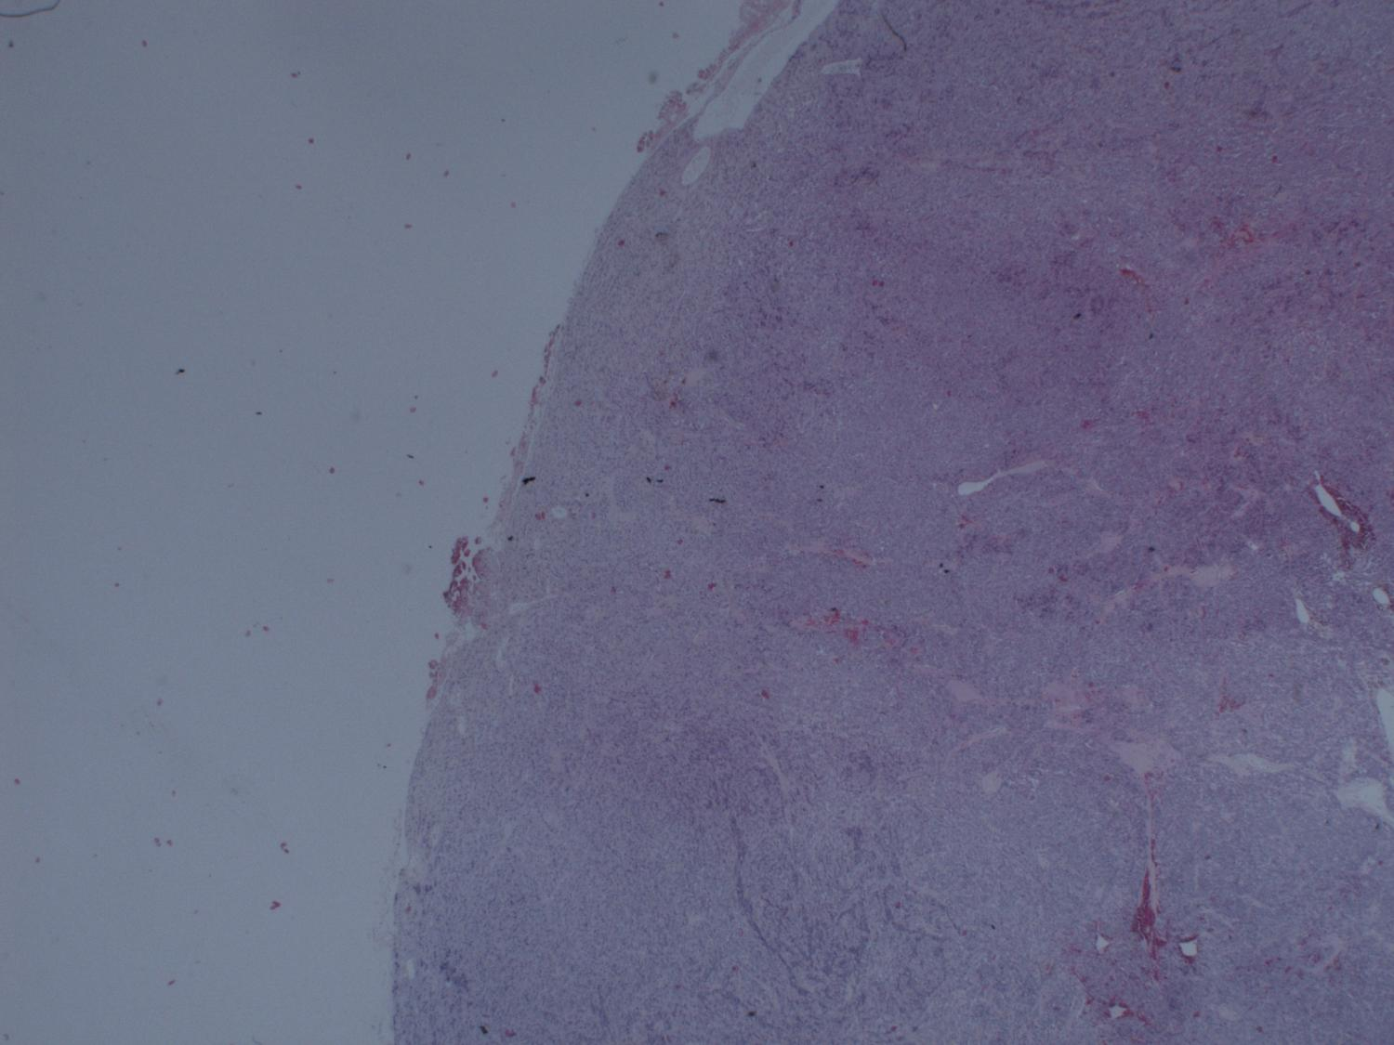

Slide 22
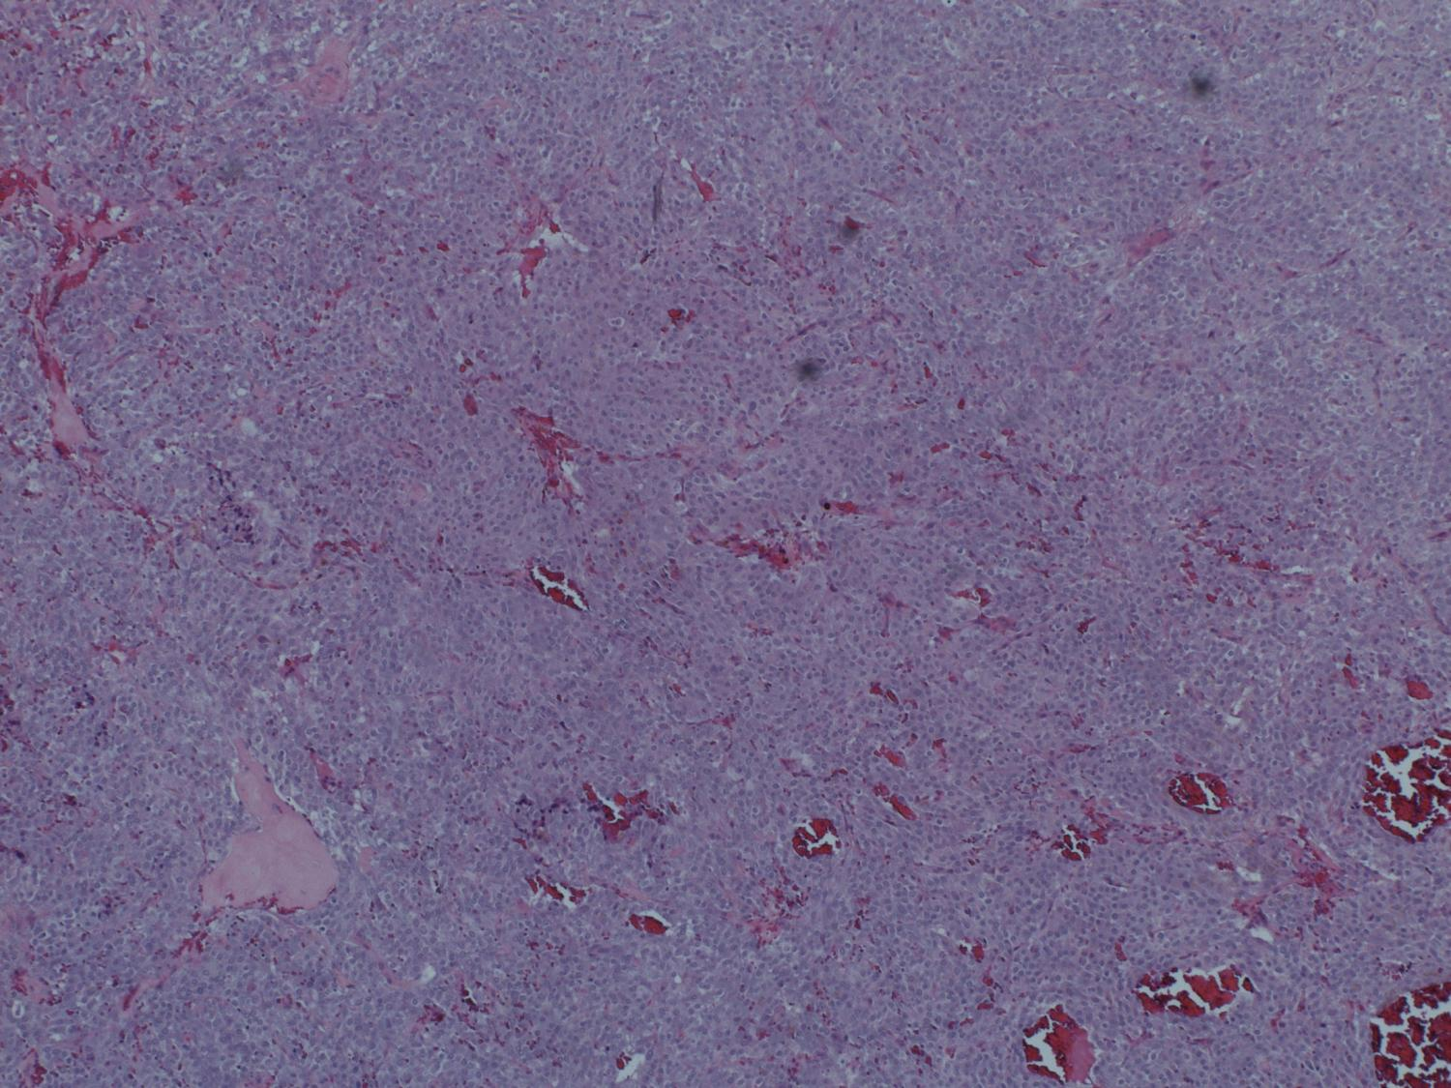

Slide 23
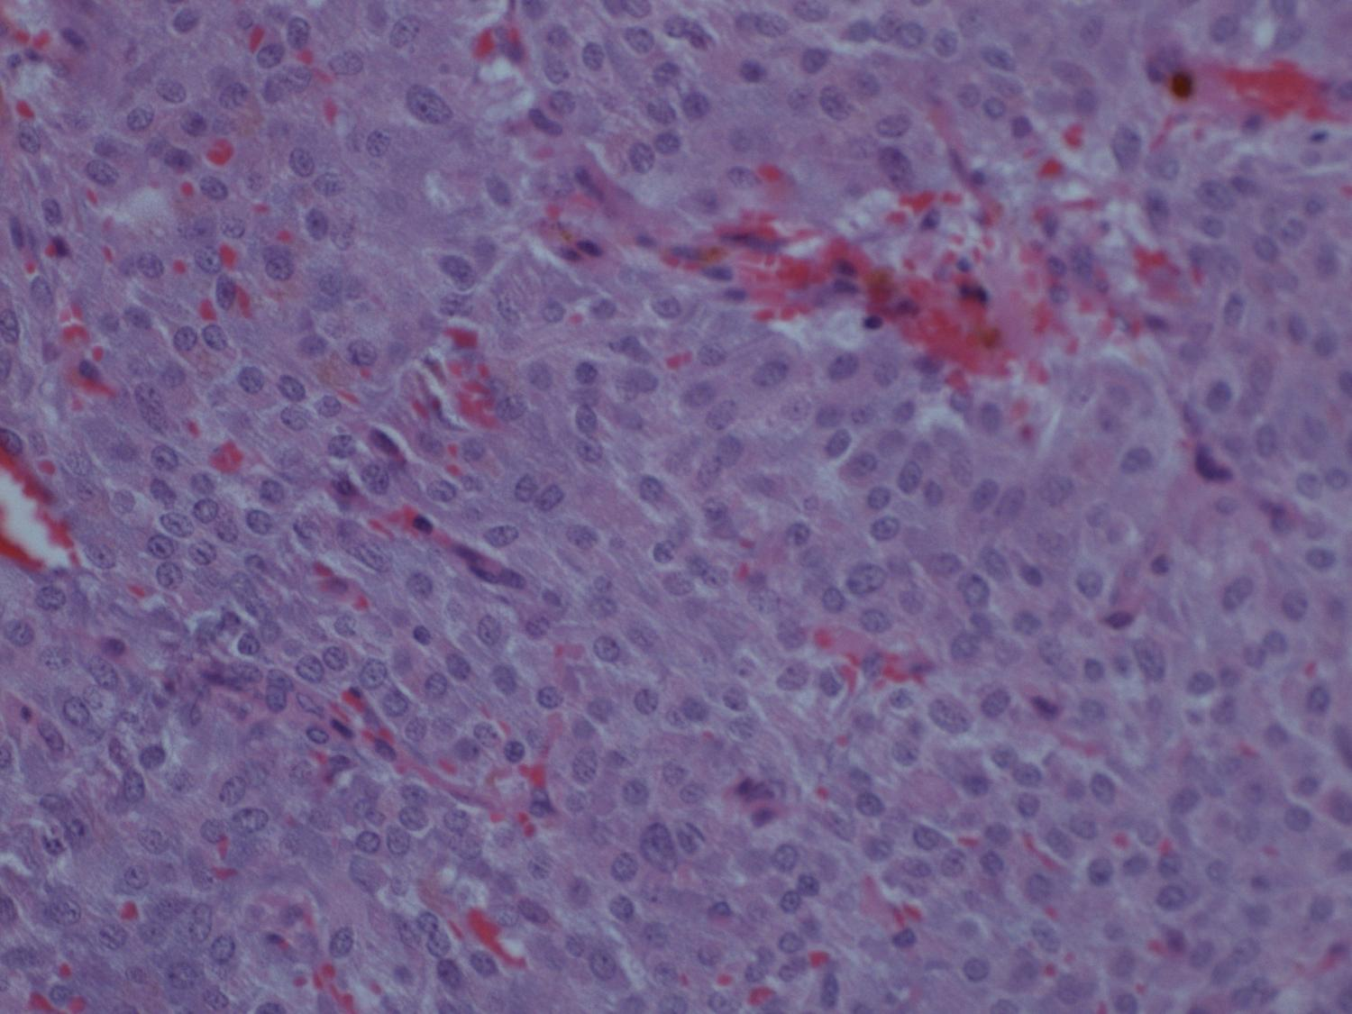

Slide 24
Case I
Diagnosis:
  Paraganglioma

Slide 25
Case I
Responses:
  Score 1 - Paraganglioma

Slide 26
Case I
Responses:
  Score 2
    Phaeochromocytoma
    Ectopic Phaeochomocytoma
    Neuroendocrine tumour

Slide 27
Case J
J.F: 56 yrs Glandular smear. 2 negative LLETZ. Hysterectomy cervix block

Slide 28
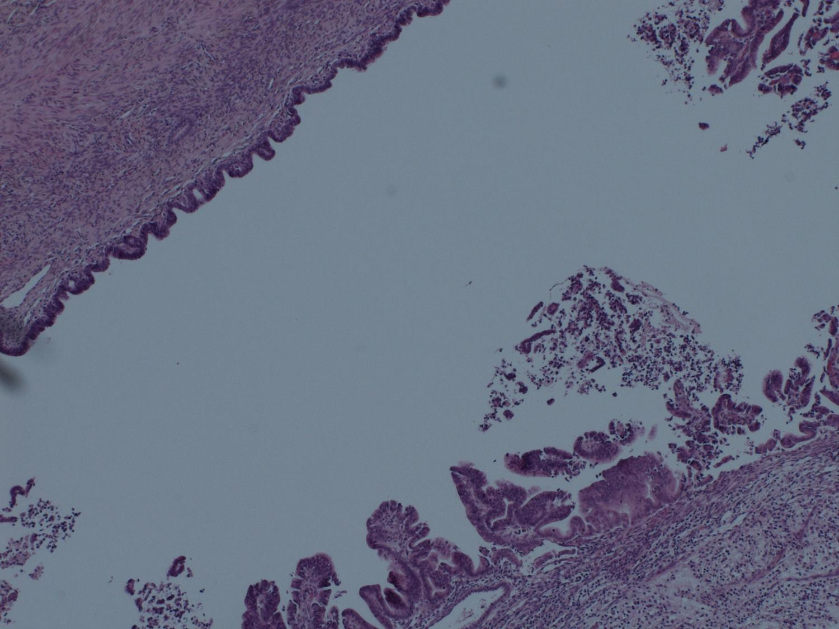

Slide 29
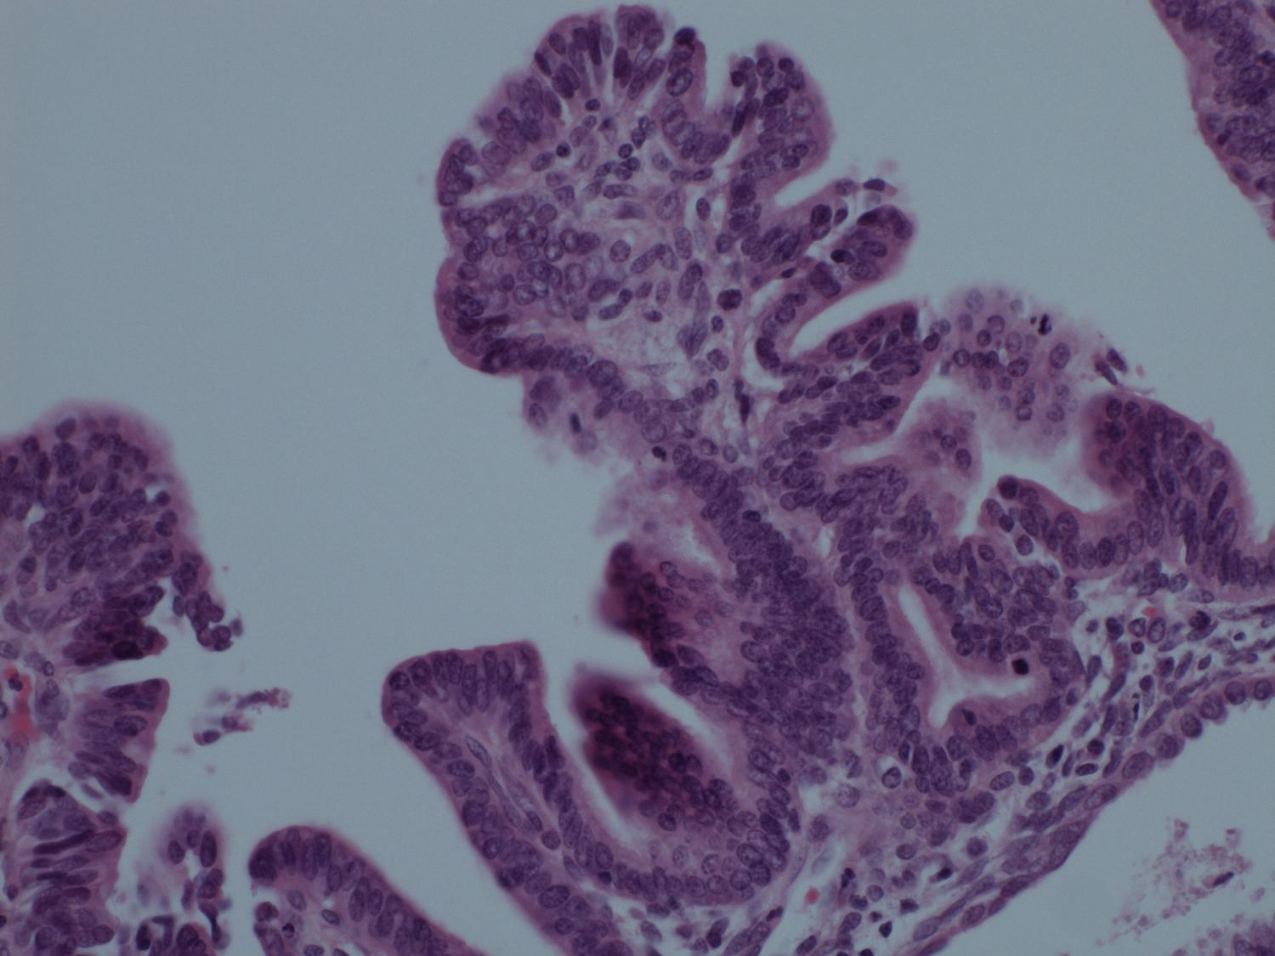

Slide 30
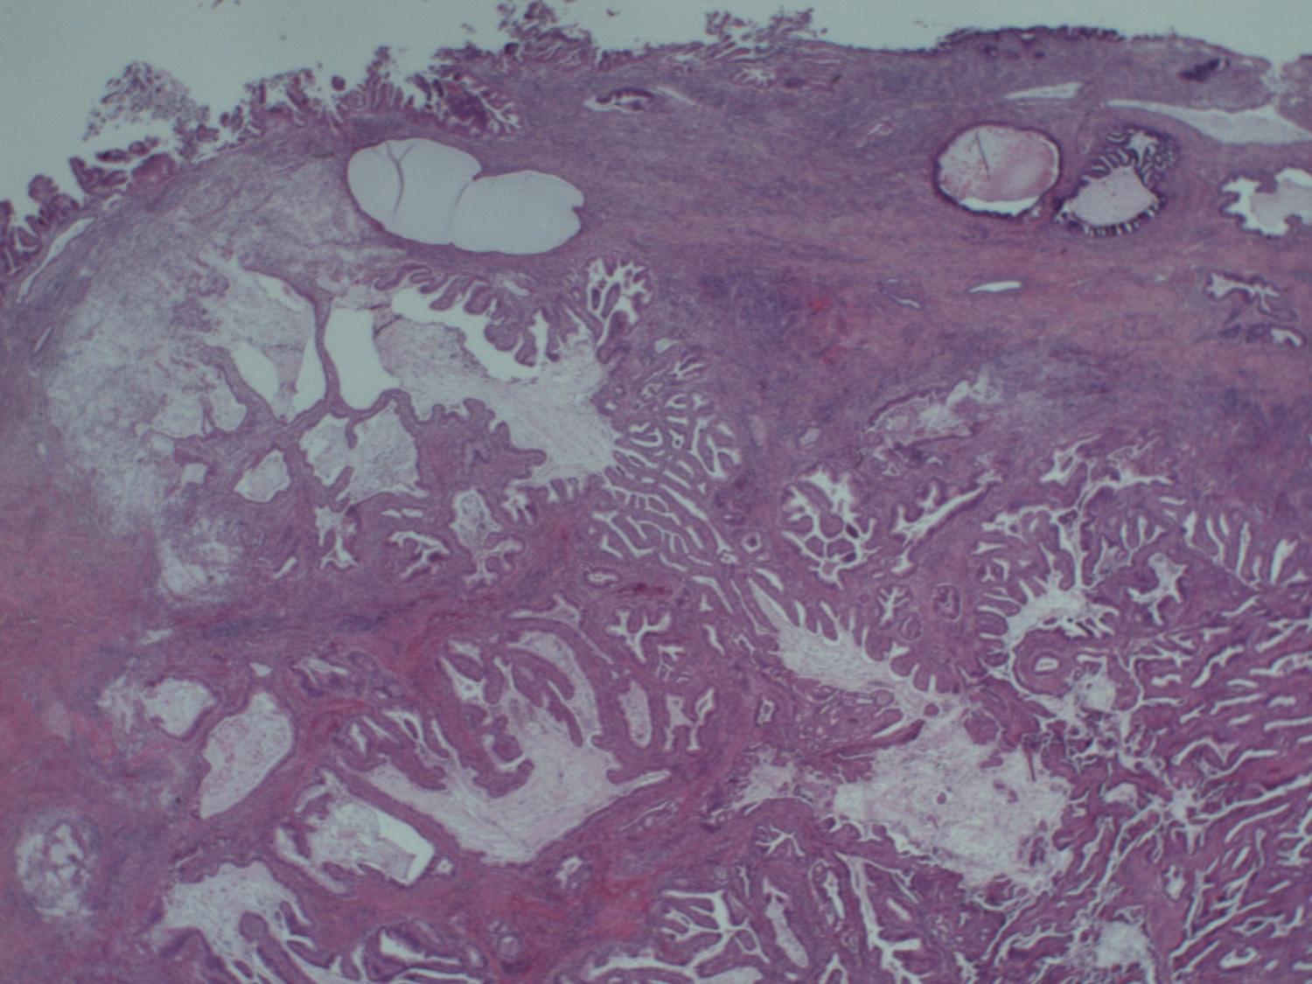

Slide 31
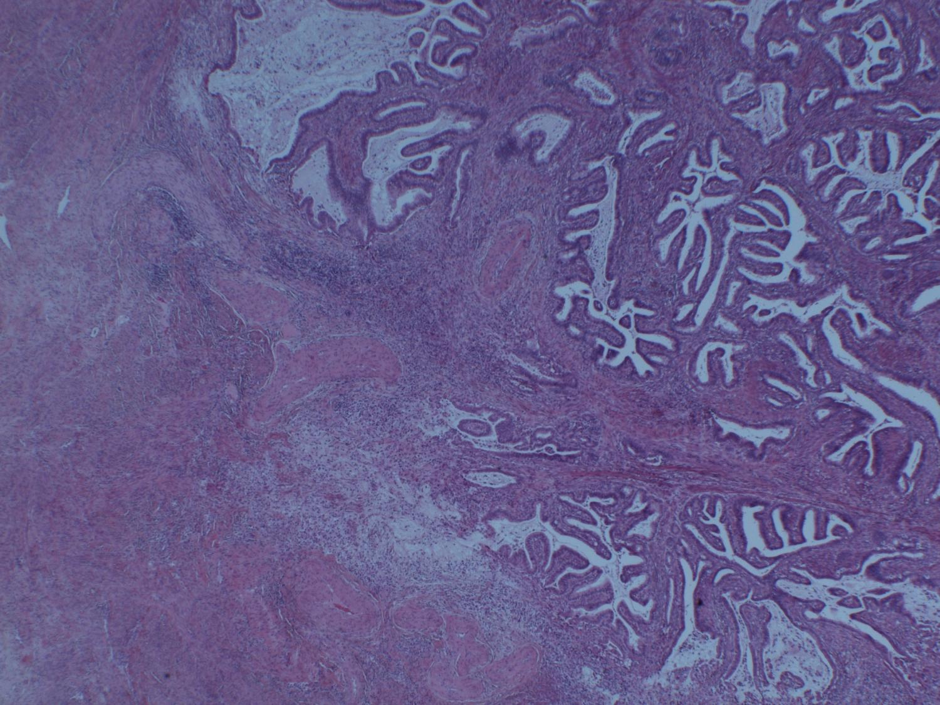

Slide 32
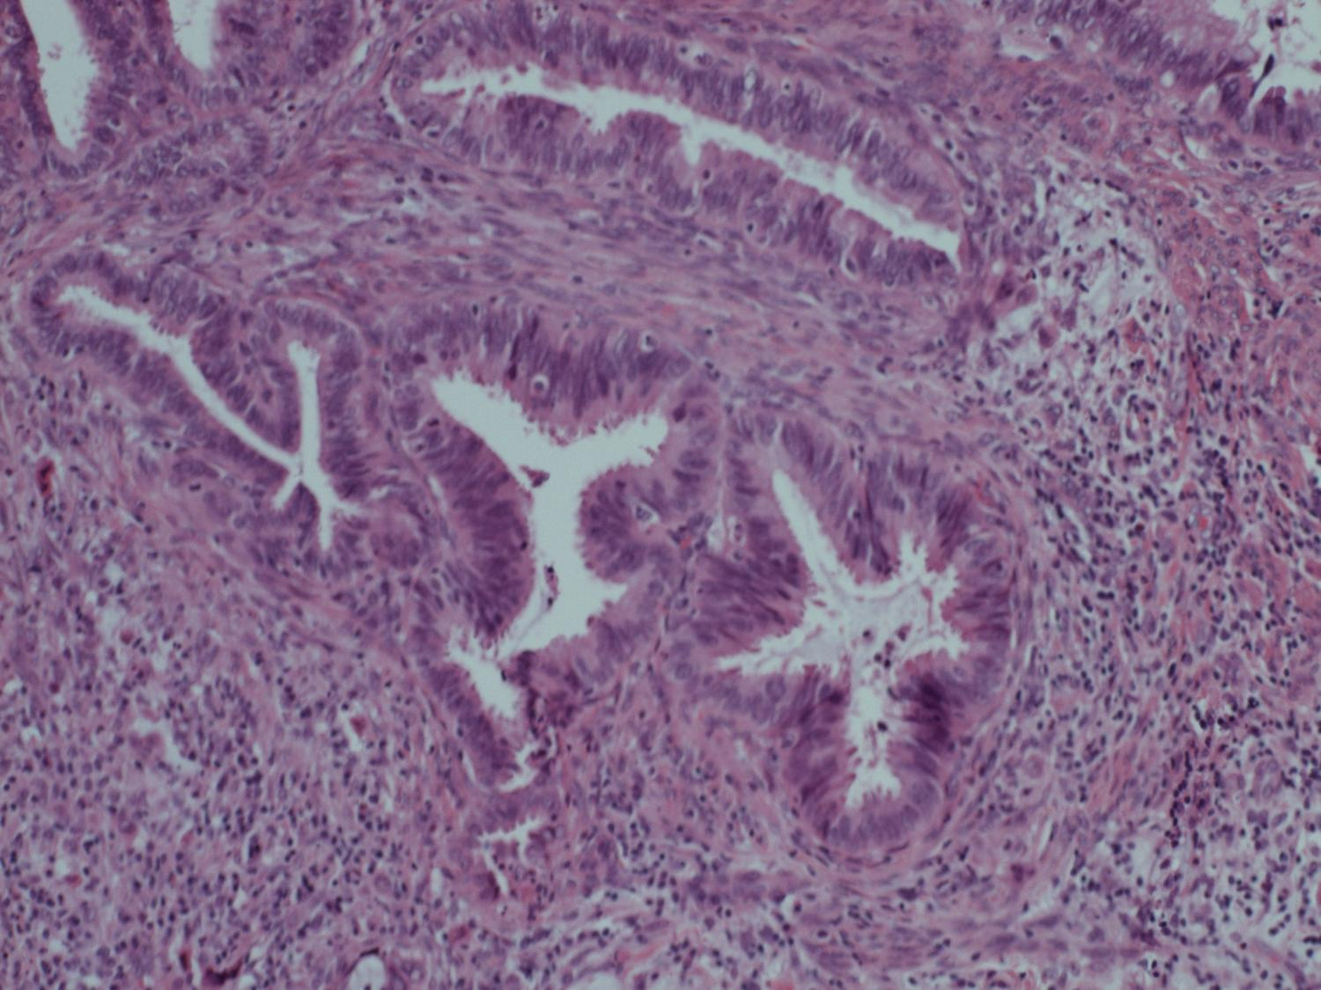

Slide 33
Case J
Diagnosis:
  Cervical Adenocarcinoma

Slide 34
Case J
Responses:
  Score 1 Cervical Adenocarcinoma +/- CGIN

Slide 35
Case J
Responses:
  Score 2
    Endometrial Adenocarcinoma
  Score 3
    HGCGIN etc
    Benign Tunnel Clusters
    Mullerian Papilloma, Erian Papilloma

