Slide 1
Scotland and Northern Ireland General EQA Scheme Educational cases E1&E2 Dr Kate Struthers

Slide 2
E1
55 year old
9mm papule right temple

Slide 3
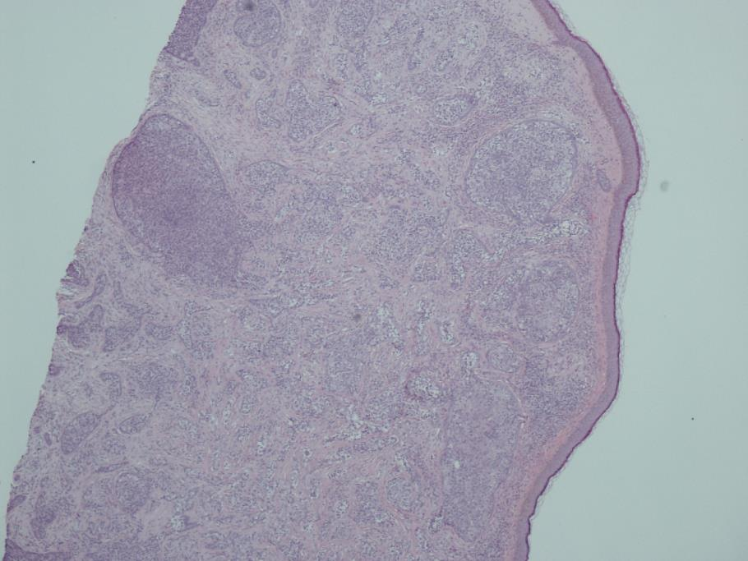
E1

Slide 4
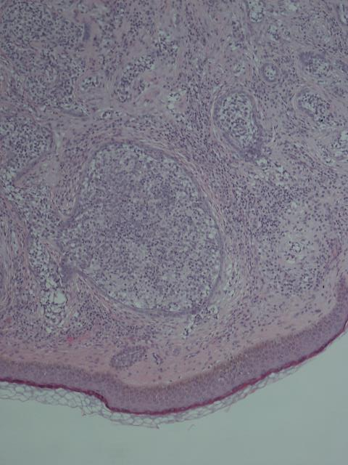
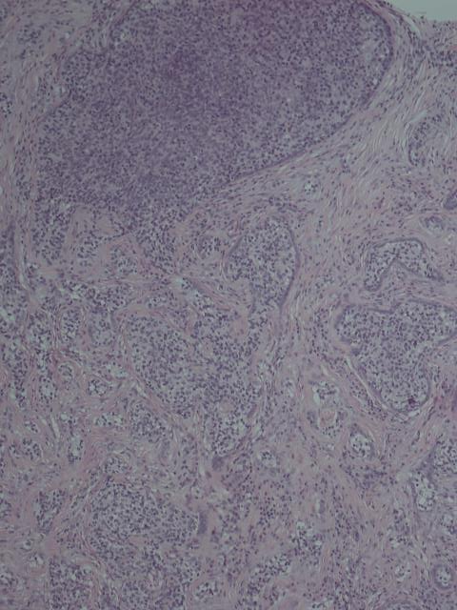
E1

Slide 5
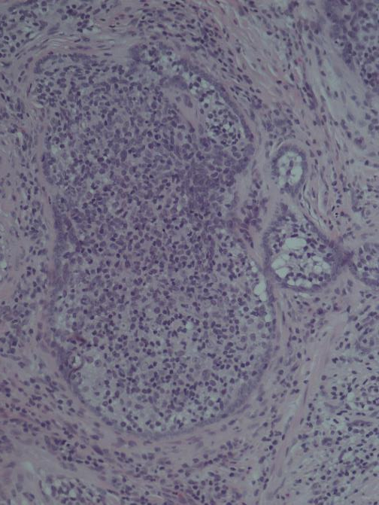
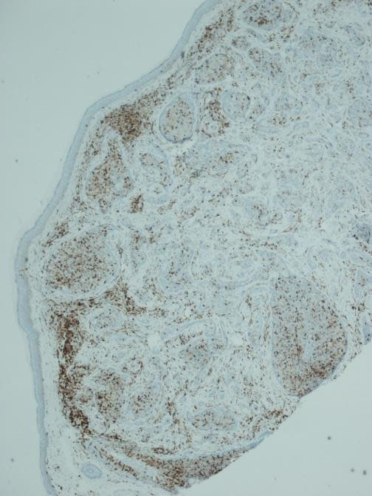
E1
CD45

Slide 6
E1
84 responses
Cutaneous Lymphadenoma (24)
Cutaneous lymphadenoma, trichoblastoma variant (3)
Cutaneous lymphadenoma, adamantanoid trichoblastoma (1)
Cutaneous adenolymphoma (1)
Lymphadenoma (6)
Lymphadenoma, variant of trichoblastoma (1)
Adnexal tumour (1)
Benign skin adnexal tumour (2)
Adnexal tumour ?cutaneous lymphadenoma (1)
Adnexal tumour ?lymphadenoma (1)
Adnexal tumour with features of desmoplastic trichoepithelioma (1)
Adnexal tumour ?malignant (1)

Slide 7
E1
Benign skin appendage tumour (?eccrine spiradenoma?cutaneous lymphadenoma) (1)
Skin adnexal tumour favour hair follicle origin ?trichepithelioma (1)
Skin adnexal tumour ?hair follicle origin (1)
?skin appendage tumour ?cutaneous lymphadenoma (1)
Skin adnexal tumour (1)
Skin adnexal tumour ?microcystic adnexal carcinoma (1)
Benign skin appendage tumour with hair follicle differentiation ?trichoepithelioma or trichoblastoma (1)
Skin adnexal tumour, favour trichoblastoma (1)
Malignant skin adnexal tumour (1)
Incompletely excised adnexal tumour. Appears to have some tricholemmal differentiation but not typical of desmoplastic variant (1)
Skin appendage tumour ?cutaneous lymphadenoma (1)
DD – sebaceous carcinoma, skin appendage carcinoma, metastatic carcinoma. Needs IHC (1)
Skin adnexal tumour ?trichelemmoma (1)

Slide 8
E1
Trichepithelioma (4)
Trichoblastoma (1)
Trichoblastoma, adamantinoid variant (1)
Trichoblastoma ?adamantinoid variant (1)
Adamantinoid trichoblastoma (1)
Trichoblastoma vs basal cell carcinoma, IHC (1)
Trichoblastic carcinoma (1)
Tricholemmal carcinoma (2)
?desmoplastic trichilemmoma (1)
?desmoplastic trichilemmoma (1)
Desmoplastic trichoblastoma (1)
Desmoplastic trichilemmoma (1)

Slide 9
E1
Microcystic adnexal carcinoma (2)
Sebaceous carcinoma (4)
Sebaceous gland carcinoma (1)
Inflamed spiradenoma (1)
Eccrine spiradenoma (1)
Some sort of poro-carcinoma (1)
Basal cell carcinoma, nodular and infiltrative (1)
Organoid basal cell carcinoma (1)

Slide 10
Cutaneous lymphadenoma
Rare benign skin adnexal tumour
Variant of trichoblastoma ‘adamantanoid trichoblastoma’
Wide age range – 14-87
Clinical presentation:
Single, small flesh-coloured nodule; well circumscribed, slowly enlarging.
Present for months/years
Site: Face, scalp, legs

Slide 11
Cutaneous lymphadenoma
Histology:
Well circumscribed dermal lesion
Variable connection to epidermis
Rounded islands / nests epithelial cells
Embedded in loose-dense stroma
Outer rim palisading cells, no retraction artefact
Dense infiltrate of small, mature lymphocytes in lobules
Some central keratinisation
May be focal follicular or sebaceous differentiation
Mitoses rare
IHC: Not necessary for diagnosis
Lymphocytes + CD45, polymorphous
+ AE1/3

Slide 12
Cutaneous lymphadenoma
Management: surgical excision
Differential diagnosis:
Basal cell carcinoma – atypia / mitotic activity / retraction artefact
Trichoblastoma – lacks lymphocytes

Slide 13
E2
60 year old female
Large necrotic uterine tumour

Slide 14
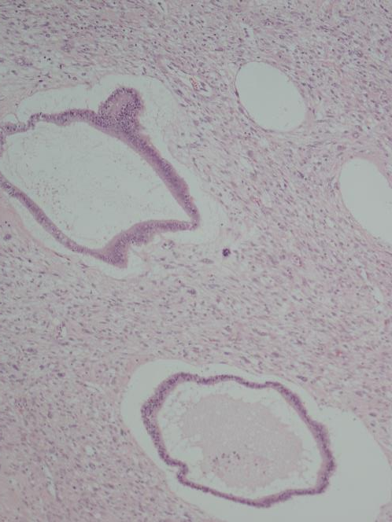
E2

Slide 15
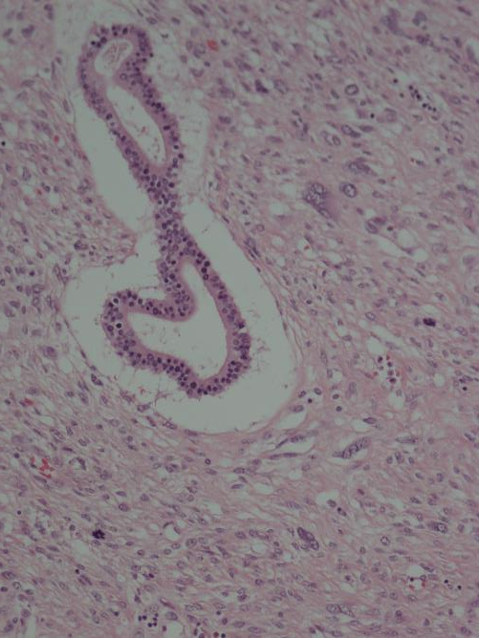
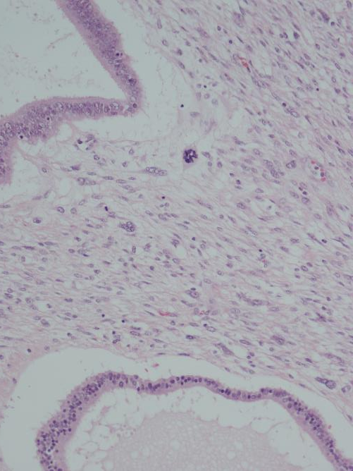
E2

Slide 16
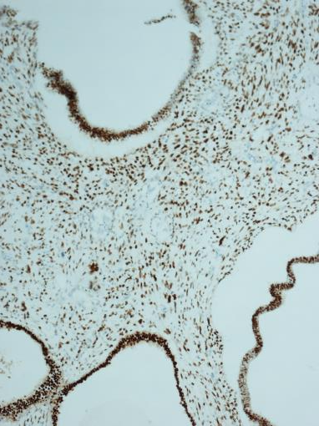
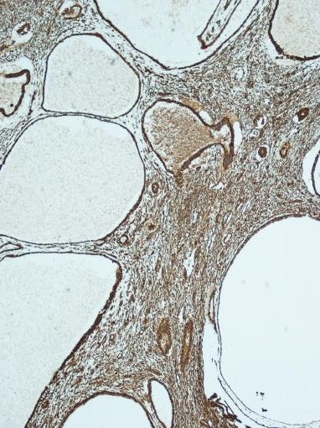
ER
MNF
Vimentin

Slide 17
E2
84 responses
Adenosarcoma (56)
Adenosarcoma of uterus (1)
Adenosarcoma, but would have to sample widely to check no carcinoma element (1)
Adenosarcoma (high grade) (1)
Adenosarcoma (leiomyosarcoma) (1)
Adenosarcoma with sarcomatous overgrowth (1)
High grade adenosarcoma (1)
Mullerian adenosarcoma (5)
Uterine / Mullerian adenosarcoma (1)

Slide 18
E2
Carcinosarcoma (7)
Carcinosarcoma vs adenosarcoma (1)
Adenosarcoma or carcinosarcoma (1)
Biphasic tumour….DD Adenosarcoma with sarcomatous overgrowth or carcinosarcoma (1)
Uterine sarcoma (1)
Uterine sarcoma, needs IHC (1)
Malignant mixed Mullerian tumour (1)
Leiomyosarcoma (1)
Leiomyosarcoma with benign epithelial elements (1)
High grade endometrial stromal sarcoma (homologous) (1)

Slide 19
Uterine (Mullerian) adenosarcoma
Mixed epithelial and stromal tumour – malignant stroma with benign epithelial component
Incidence highest in perimenopausal or postmenopausal women
Risk factors: Endometriosis, pelvic radiotherapy, long term unopposed oestrogen and tamoxifen
Clinical presentation: Abnormal bleeding, pelvic pain, incidental
Diagnosed on endometrial biopsy

Slide 20
Adenosarcoma
Macroscopy:
Often polypoidal, filling endometrial cavity
Cut surface solid and white containing microcysts/mucoid material
Microscopy:
Biphasic tumour with admixed glands and stroma
Stroma cytologically atypical with mitotic activity
Epithelium usually endometrioid, but can show mucinous, tubal or squamous metaplasia

Slide 21
Adenosarcoma
Low grade – monotonous stromal nuclei, mild to moderate atypia
High grade – pleomorphic, markedly atypical nuclei noticeable at low power
Sarcomatous overgrowth – sarcoma without any epithelial elements in >25% of the tumour
Heterologous elements – most commonly rhabdomyosarcoma
Immunohistochemistry – Glands: AE1/3, ER, PR
Stroma: Vimentin, CD10, WT1, ER, PR; variable smooth muscle markers

Slide 22
Uterine sarcomas – FIGO staging
Adenosarcoma staged in a comparable way to endometrial carcinomas, as they tend to arise on the surface and progressively invade the myometrium or cervical stroma
Leiomyosarcomas and endometrial stromal sarcomas arise within the myometrium and are staged differently, as are undifferentiated sarcomas and pure heterologous tumours
Carcinosarcoma staged as carcinoma of the uterine corpus

