Slide 1
Scotland and Northern Ireland EQA Scheme Circulation 50
Cases A to E
Presented by Dr YL Woods

Slide 2
Scotland and Northern Ireland EQA Scheme Circulation 50
Cases F to J
Presented by Dr S Mukhtar

Slide 3
Case F
60 year old male
New skin lump left abdomen. Immunohistochemistry – vimentin, CD10, PAX8, EMA positive. BerEP4, S100, p63 negative
Previous history SSMM left knee and recent diagnosis colonic adenocarcinoma

Slide 6
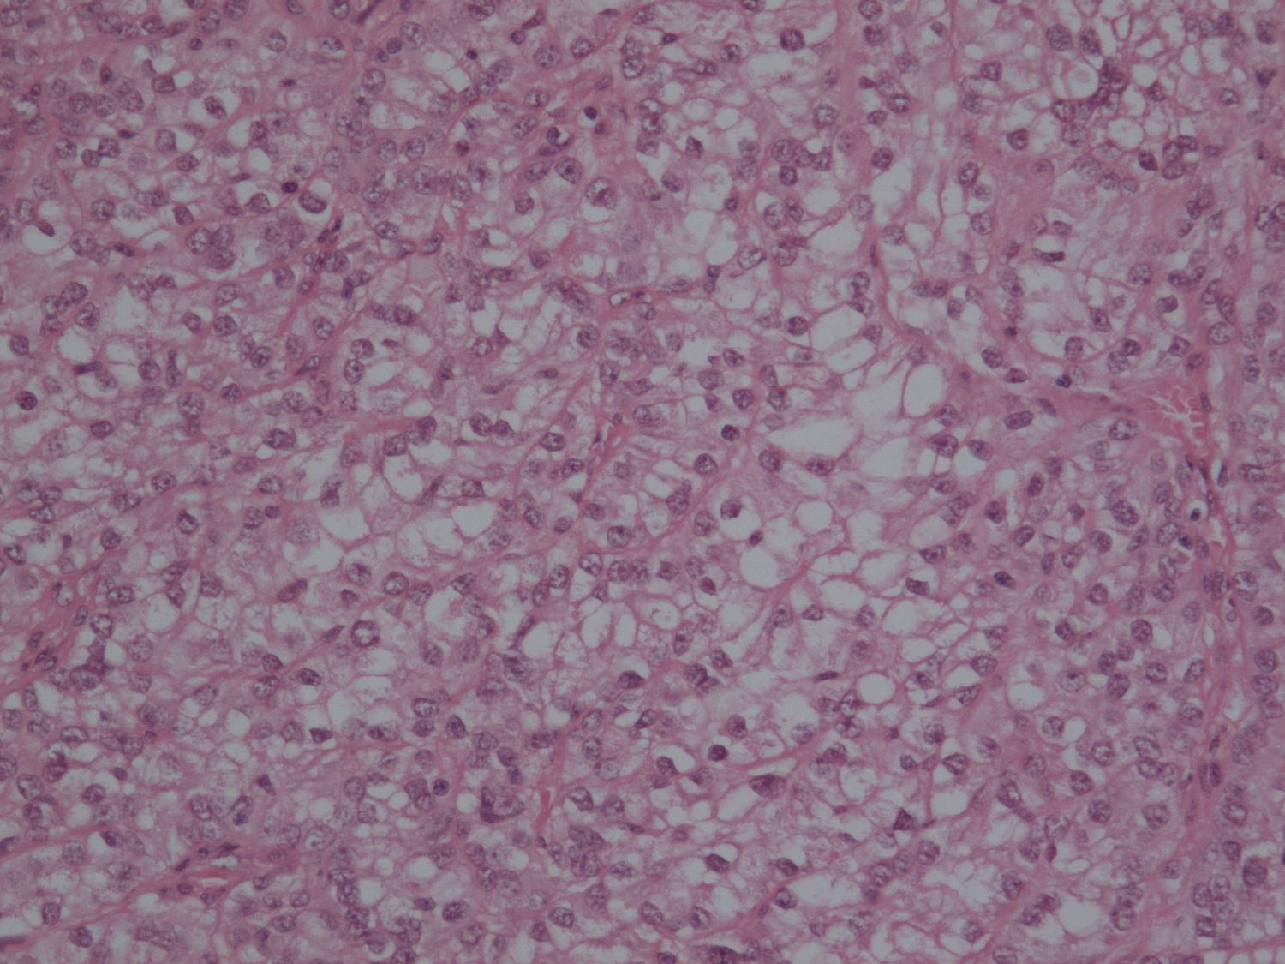

Slide 7
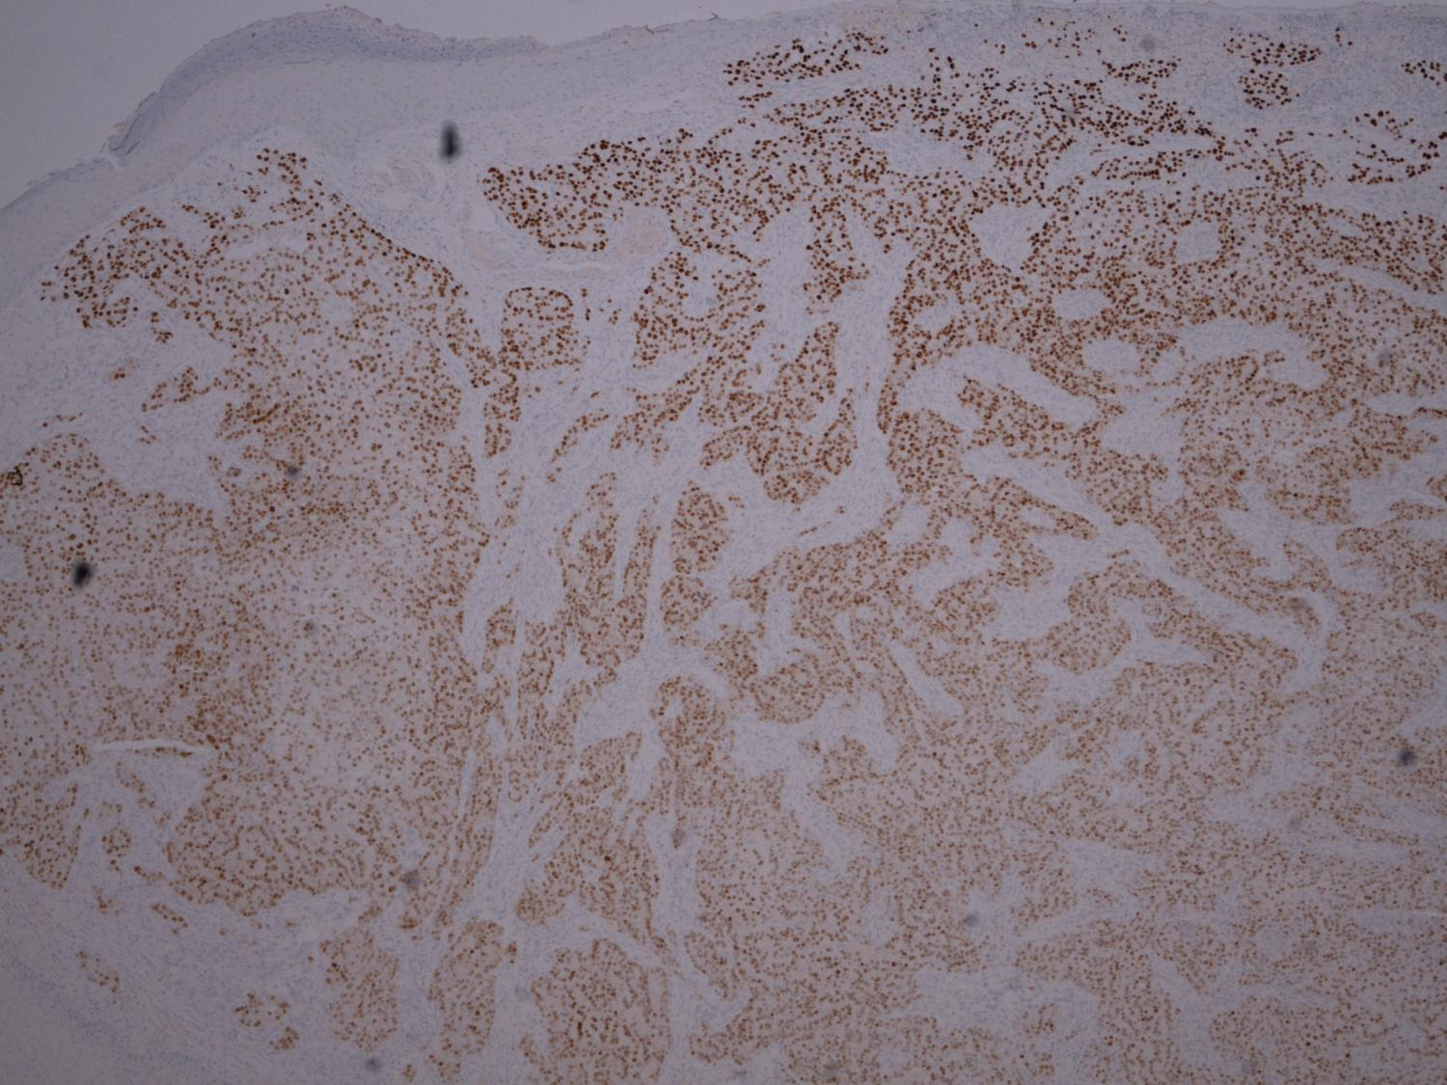
PAX8

Slide 8
Case F
Diagnosis:
Metastatic clear cell renal cell carcinoma

Slide 9
Case F
Responses: 112
Score 1
110 – (metastatic) clear cell renal cell carcinoma
1 – clear cell carcinoma (metastatic)
1 – metastatic carcinoma (PAX8 positive in RCC, some thyroid carcinomas)

Slide 10
Case G
62 year old male
Excision nodule tip of tongue

Slide 12
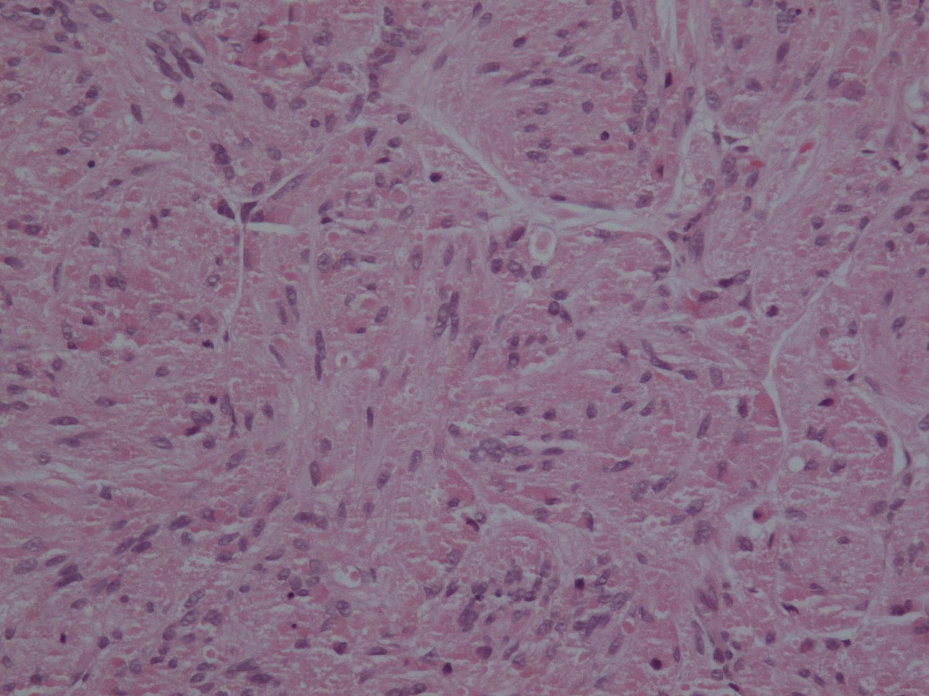

Slide 13
Case G
Diagnosis:
Granular cell tumour

Slide 14
Case G
Responses: 112
Score 1
107 – granular cell tumour

Slide 15
Case G
Responses: 112
Score 2
3 – traumatic neuroma
1 - neuroma
1 – benign neural tumour - schwannoma

Slide 16
Case H
42 year old female
Lump from lateral aspect of C/S scar

Slide 19
Case H
Diagnosis:
Endometriosis

Slide 20
Case H
Responses: 112
Score 1
112 - endometriosis

Slide 21
Case I
18 year old male
Symptomatic phimosis
Foreskin excision

Slide 24
Case I
Diagnosis:
Balanitis xerotica obliterans/lichen sclerosis et atrophicus

Slide 25
Case I
Responses: 112
Score 1
112 – balanitis xerotica obliterans/lichen sclerosis et atrophicus

Slide 26
Case J
66 year old male
Right superficial parotidectomy

Slide 29
Case J
Diagnosis:
Warthin’s tumour

Slide 30
Case J
Responses: 112
Score 1
112 – Warthin’s tumour

Slide 31
Case A
F: 53 years
Lesion right distal forearm

Slide 34
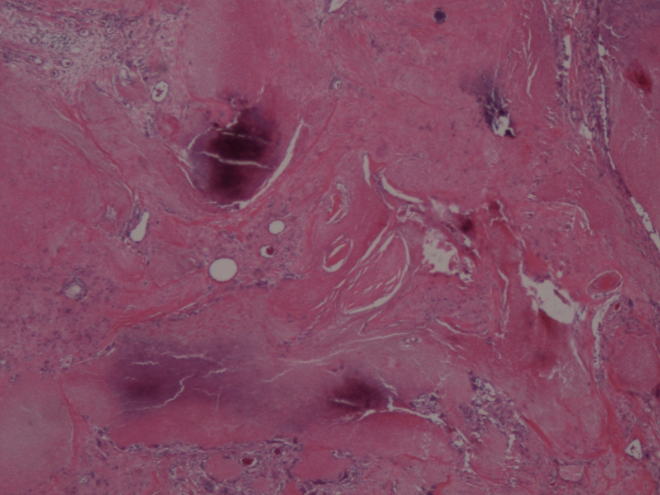

Slide 35
Case A
Diagnosis:
Pilomatrixoma

Slide 36
Case A
Responses:
Score 1
104 – pilomatrixoma
1-calcifying epithelioma of malherbe
Score 2
1 – molluscum contagiosum
Score 3
0

Slide 37
Case B
M: 57 years
Lymph node. Hilar lymphadenopathy

Slide 40
Case B
Diagnosis:
Granulomatous inflammation, in keeping with sarcoidosis

Slide 41
Case B
Responses:
Score 1
103 – granulomatous inflammation, favour sarcoidosis
1 – non-caseating granulomatous inflammation
1 – granulomatous lymphadenitis
1- Non necrotising granulomatous lymphadenopathy
Score 2
0
Score 3
0

Slide 42
Case C
M: 63 yrs
Oesophageal biopsies. Non specific oesophagitis (low grade)
Post autologous BMT. No obvious candida ?Nature of inflammation

Slide 45
Case C
Diagnosis:
CMV (cytomegalovirus) oesophagitis

Slide 46
Case C
Responses:
Score 1
102 - CMV (cytomegalovirus) oesophagitis
1-CMV associated ulceration
1-CMV infection
Score 2
2 – Herpes simplex oesophagitis
Score 3
0

Slide 47
Case D
M: 36 years
Left epididymal tumour

Slide 50
Case D
Diagnosis:
Adenomatoid tumour

Slide 51
Case D
Responses:
Score 1
106 – adenomatoid tumour
Score 2
0
Score 3
0

Slide 52
Case E
F: 59 years
Incisional biopsy right breast. Right breast cancer 2011 (lumpectomy, node biopsy & radiotherapy)
Indurated haemorrhagic plaques covering most of right breast, with some superficial ulcers

Slide 55
Case E
Diagnosis:
High grade angiosarcoma

Slide 56
Case E
Responses:
Score 1
103 –angiosarcoma
1-Epithelial angiosarcoma
1-Post radiation therapy angiosarcoma
1-Haemangiosarcoma
Score 2
0
Score 3
0

