Slide 1
Scotland and Northern Ireland EQA Scheme Circulation 46
Cases A to E
Presented by Dr G Stenhouse
Raigmore Hospital, Inverness

Slide 2
Case A
46 year old Female
Thyroid lobectomy

Slide 3
Scotland and Northern Ireland EQA Scheme Circulation 46
Cases F to J
Cases provided by Dr C Boyd

Slide 4
Case F
64 year old female
History of rheumatoid arthritis. Nodule in right thumb

Slide 6
20x

Slide 7
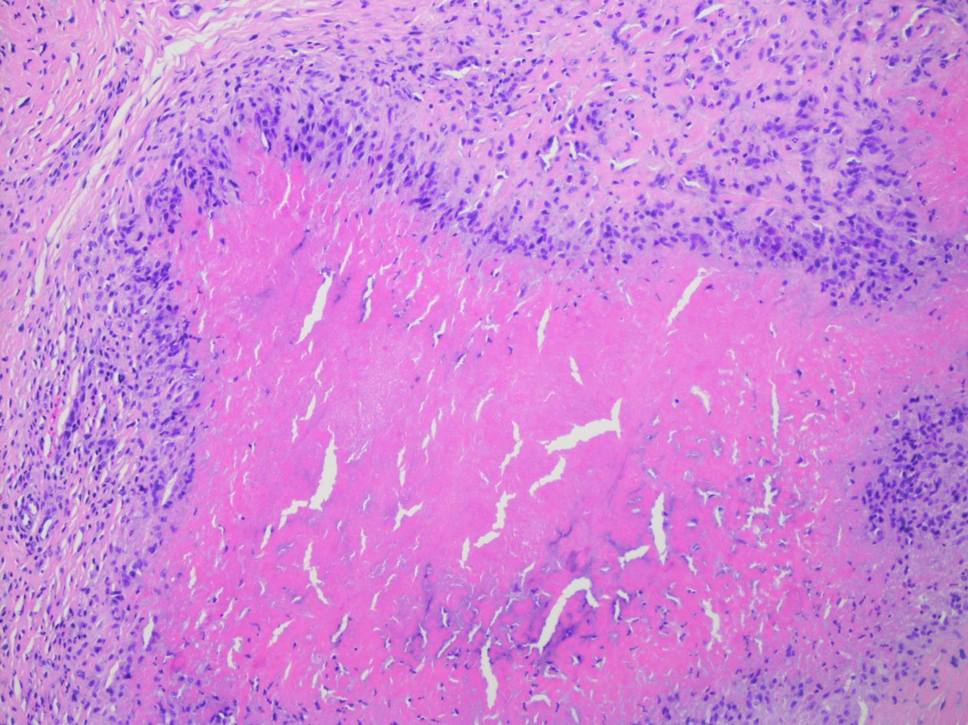
100x

Slide 8
Case F
Diagnosis:
Rheumatoid nodule

Slide 9
Case F
Responses:
Score 1
116- rheumatoid nodule (some suggested ICC to exclude epithelioid sarcoma)

Slide 11
Case G
91 year old female
Enlarging nodular lesion on left forearm

Slide 13
20x

Slide 14
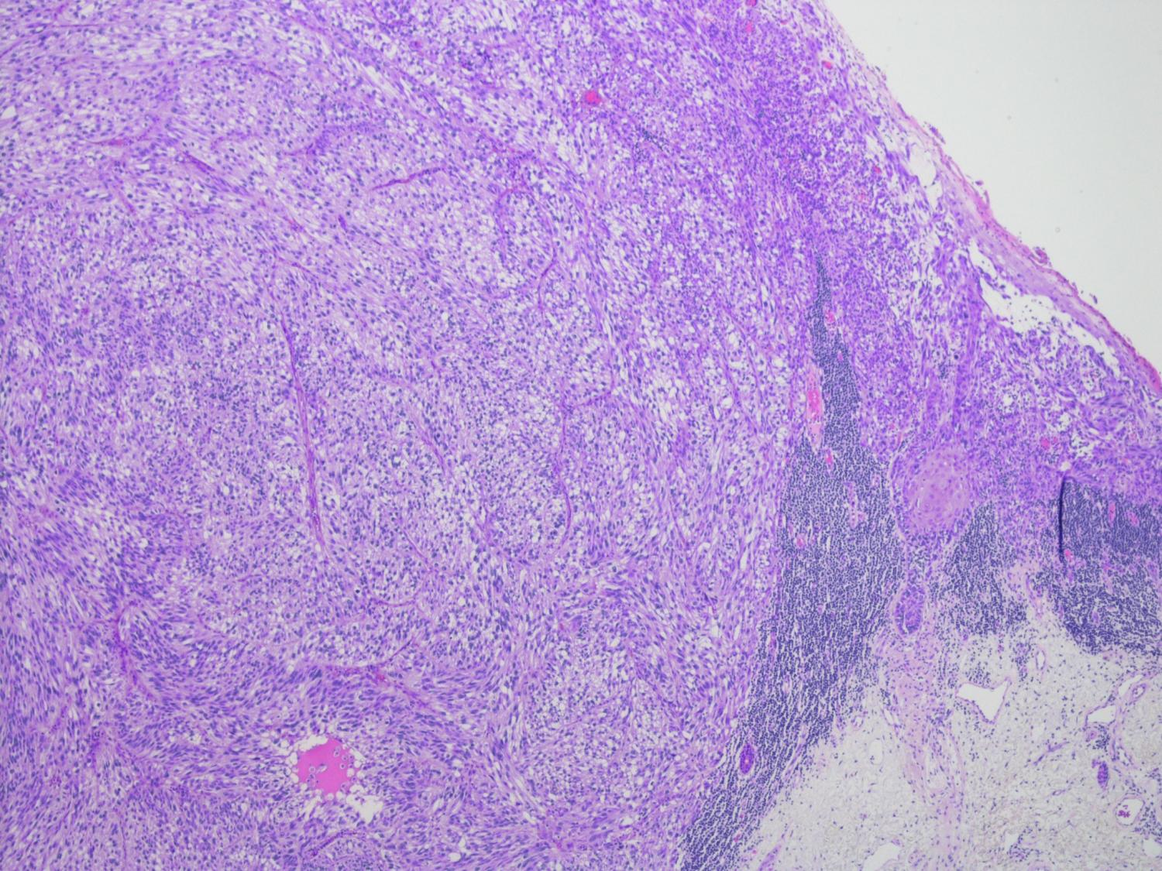
40x

Slide 15
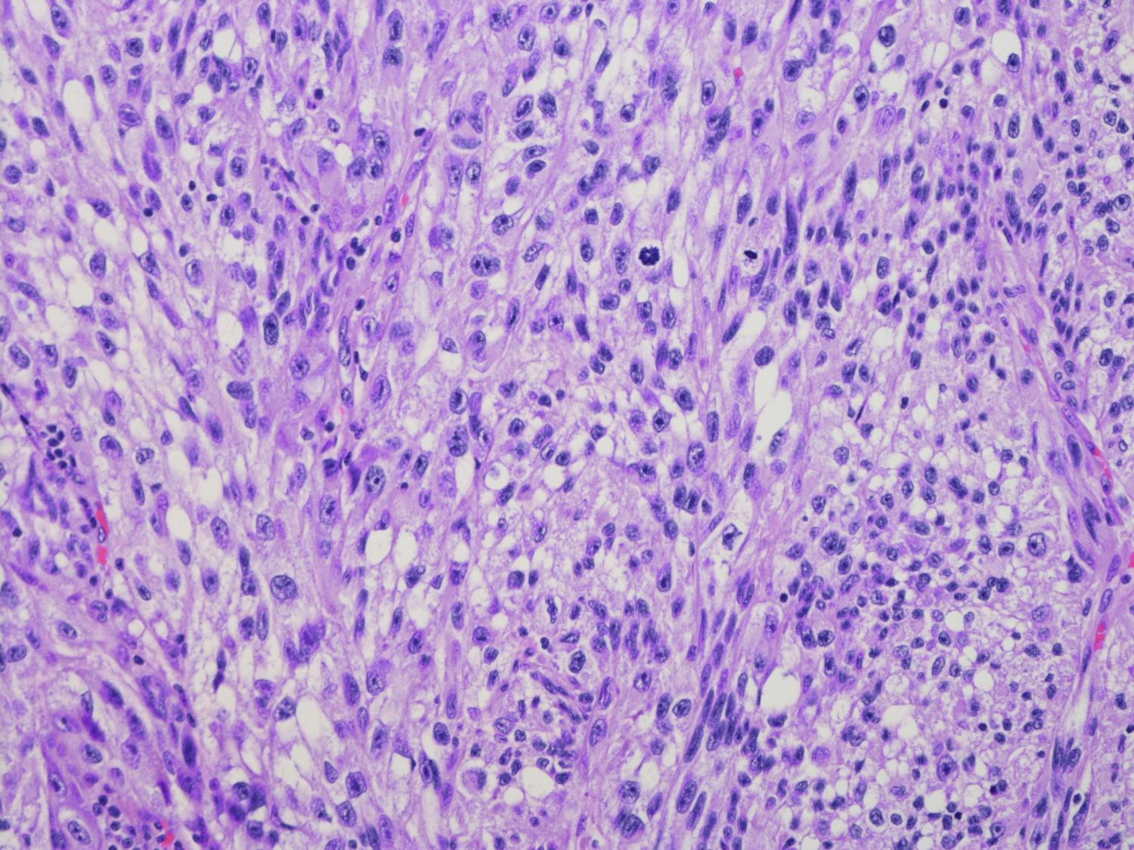
200x

Slide 16
Case G
Diagnosis:
Melanoma

Slide 17
Case G
Responses:
Score 1
115 – melanoma

Slide 18
Case G
Responses:
Score 2
1 – extraocular sebaceous carcinoma

Slide 20
Case H
36 year old female
Left breast lump excised

Slide 22
20x

Slide 23
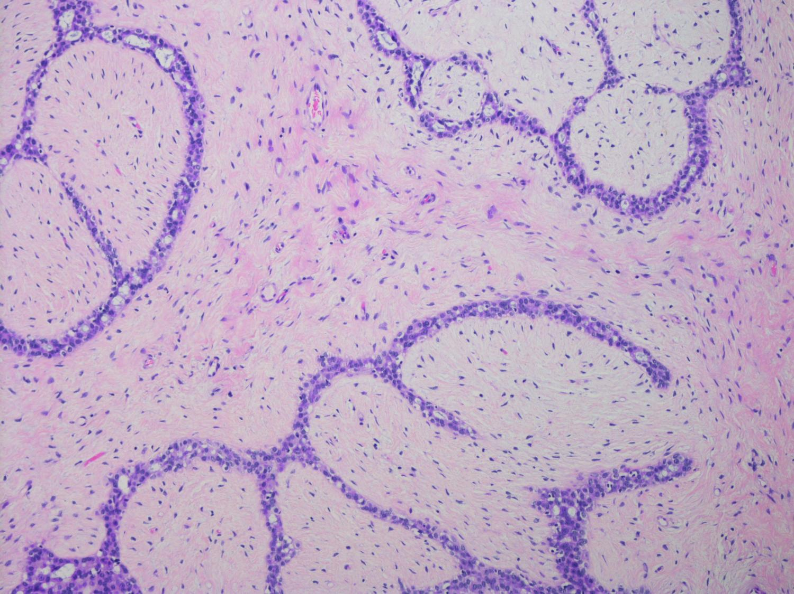
100x

Slide 24
Case H
Diagnosis:
Fibroadenoma

Slide 25
Case H
Responses:
Score 1
114 – fibroadenoma

Slide 26
Case H
Responses:
Score 2
2 – benign phyllodes tumour/ phyllodes tumour

Slide 28
Case I
67 year old male
Tumour in terminal ileum

Slide 30
20x

Slide 31
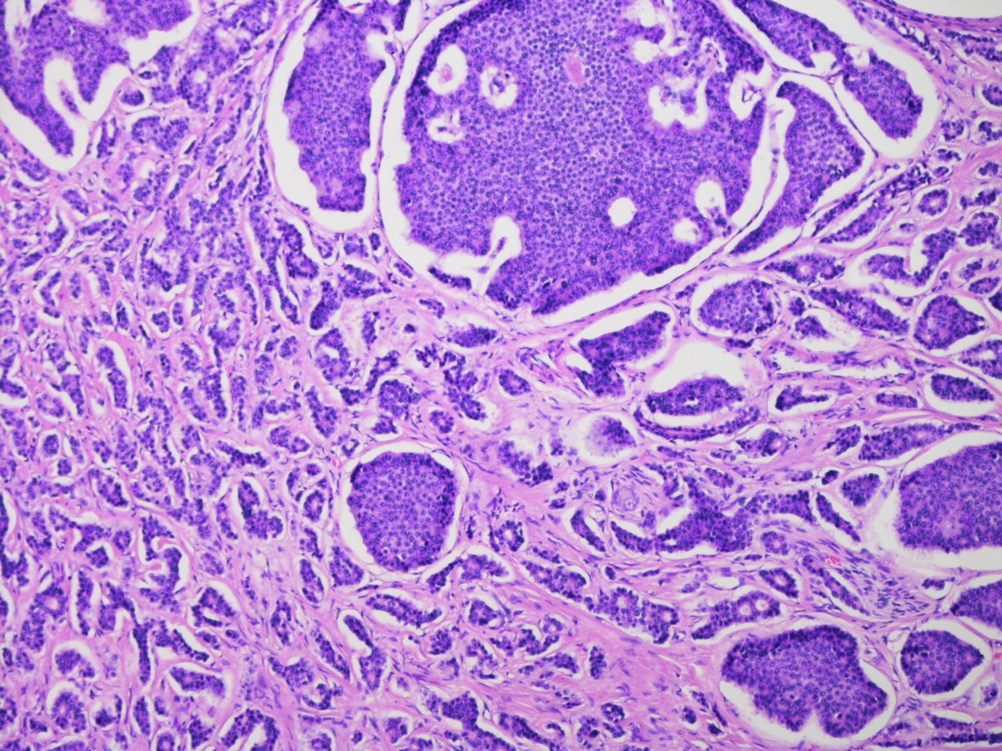
100x

Slide 32
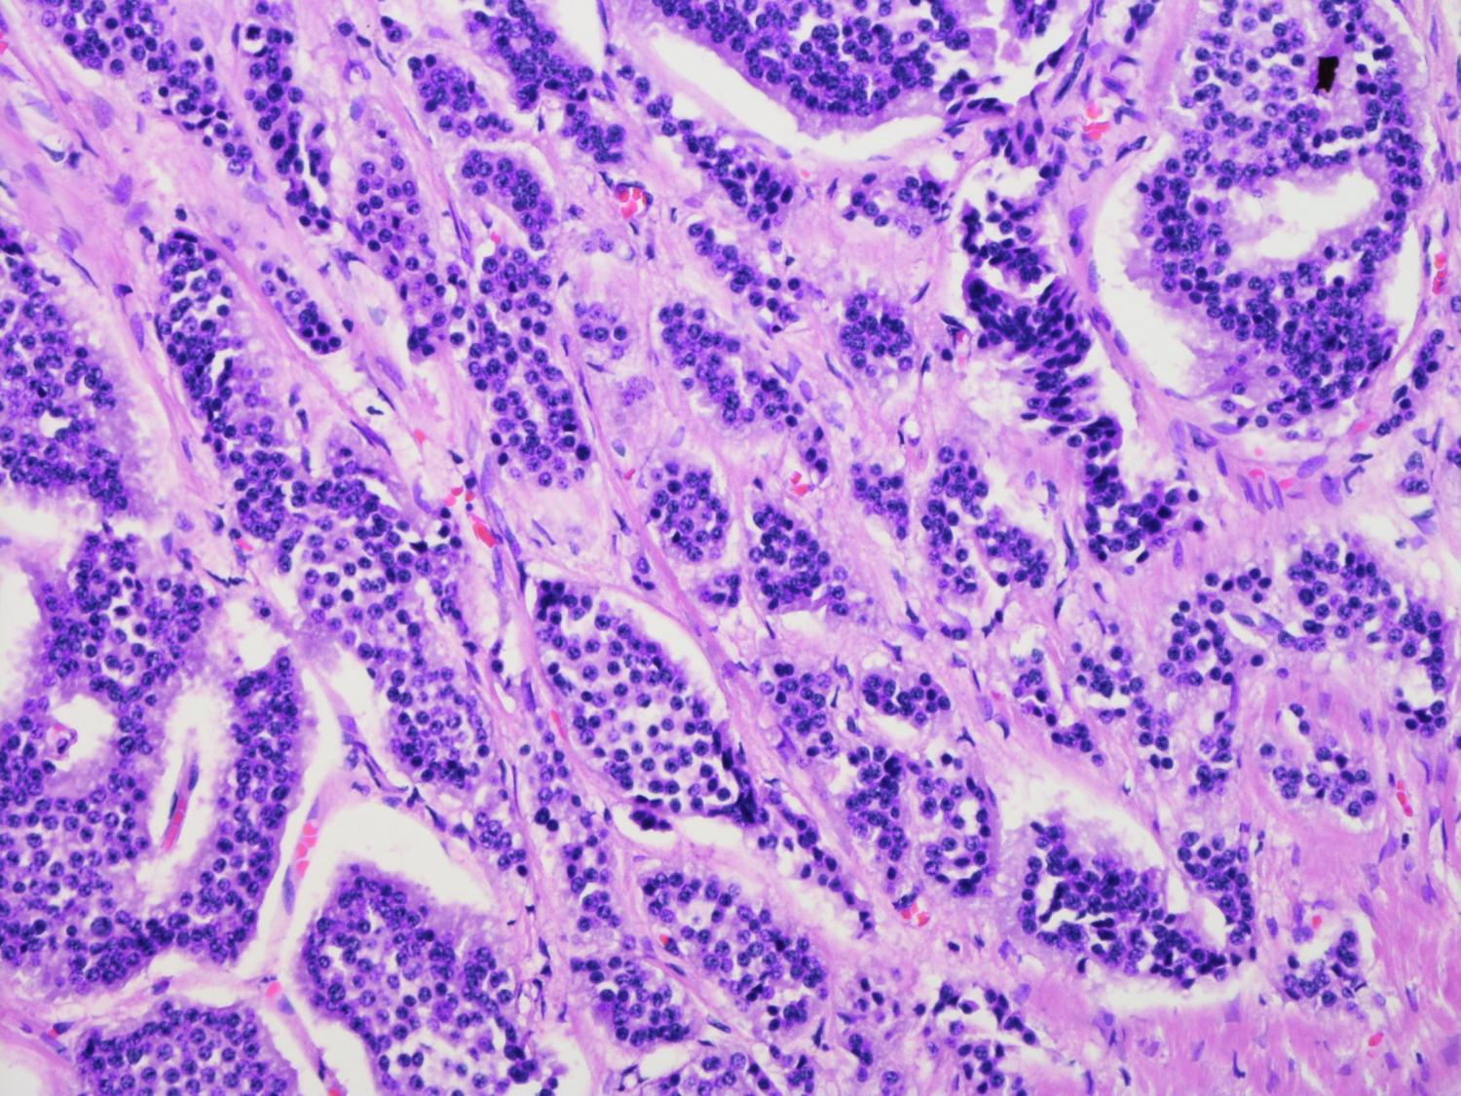
200x

Slide 33
Case I
Diagnosis:
Well differentiated neuroendocrine tumour

Slide 34
Case I
Responses:
Score 1
116 – well differentiated neuroendocrine tumour

Slide 36
Case J
7 year old male
Small tag on neck since birth

Slide 37
20x

Slide 38
40x

Slide 39
Case J
Diagnosis:
Accessory tragus

Slide 40
Case J
Responses:
Score 1
112 – accessory tragus/ accessory auricle

Slide 41
Case J
Responses:
Score 2
3 – extraosseous chondroma/ extraskeletal chondroma/ chondroma
1 – fibroepithelial polyp with cartilage

Slide 45
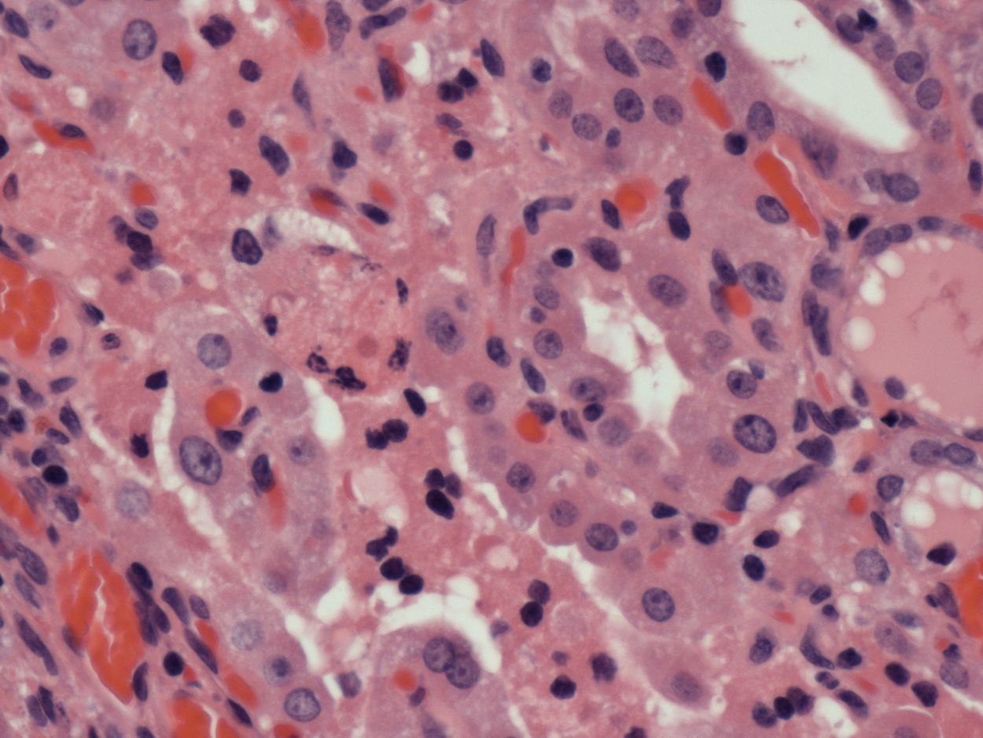

Slide 46
Case A
Diagnosis:
Chronic lymphocytic thyroiditis

Slide 47
Case A
Responses:
Score 1
107- Chronic lymphocytic thyroiditis
/Hashimoto’s thyroiditis

Slide 48
Case A
Responses:
Score 2
7 – Autoimmune thyroidits
1 – Graves Disease
Score 3
1 – Follicular Carcinoma

Slide 50
Case B
66 year old female
Gastrectomy for peritonitis

Slide 51
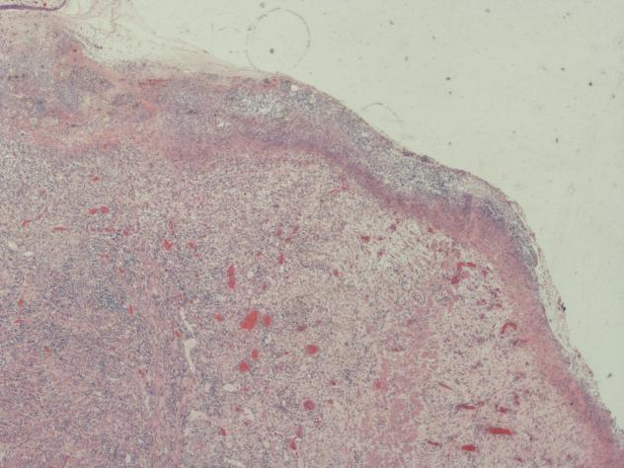
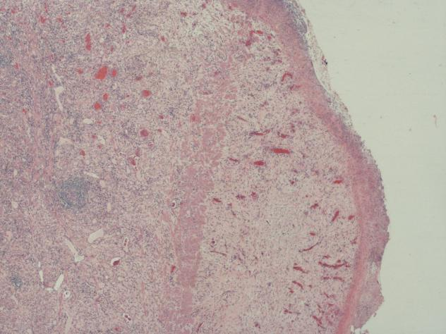
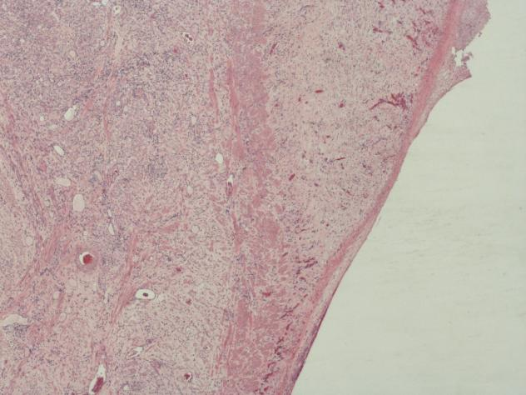

Slide 53
Case B
Diagnosis:
Benign gastric ulceration/perforation

Slide 54
Case B
Responses:
Score 1
114 – Benign gastric ulcer/perforation

Slide 55
Case B
Responses:
Score 2
1 – Fungal Ulcer
Score 3
1 – Perforation likely lymphoma destroyed by chemo. Small residual focus

Slide 57
Case C
63 year old male
Supraclavicular lymph node.
Previous follicular lymphoma

Slide 61
Case C
Diagnosis:
Follicular lymphoma

Slide 62
Case C
Responses:
Score 1
110 – Follicular Lymphoma

Slide 63
Case C
Responses:
Score 3
1 – Reactive lymph node, Follicular Hyperplasia
2 – As above but will do IHC
1 – Benign reactive (no mention of IHC)
1 – Follicular hyperplasia I might do IHC
1 – Follicular lymphoma versus reactive – IHC/Mol Gen

Slide 65
Case D
76 year old male
Gastric polyp. EMR.

Slide 70
Case D
Diagnosis:
Inflammatory Fibroid Polyp

Slide 71
Case D
Responses:
Score 1
114 – Inflammatory fibroid polyp

Slide 72
Case D
Responses:
Score 2
1 – Inflammatory or hyperplastic polyp
Score 3
1 - GIST

Slide 74
Case E
53 year old female
Right Parotid Mass

Slide 78
Case E
Diagnosis:
Pleomorphic salivary adenoma

Slide 79
Case E
Responses:
Score 1
115 – Pleomorphic adenoma

Slide 80
Case E
Responses:
Score 3
1 – Pleomorphic salivary carcinoma

